Slide 1
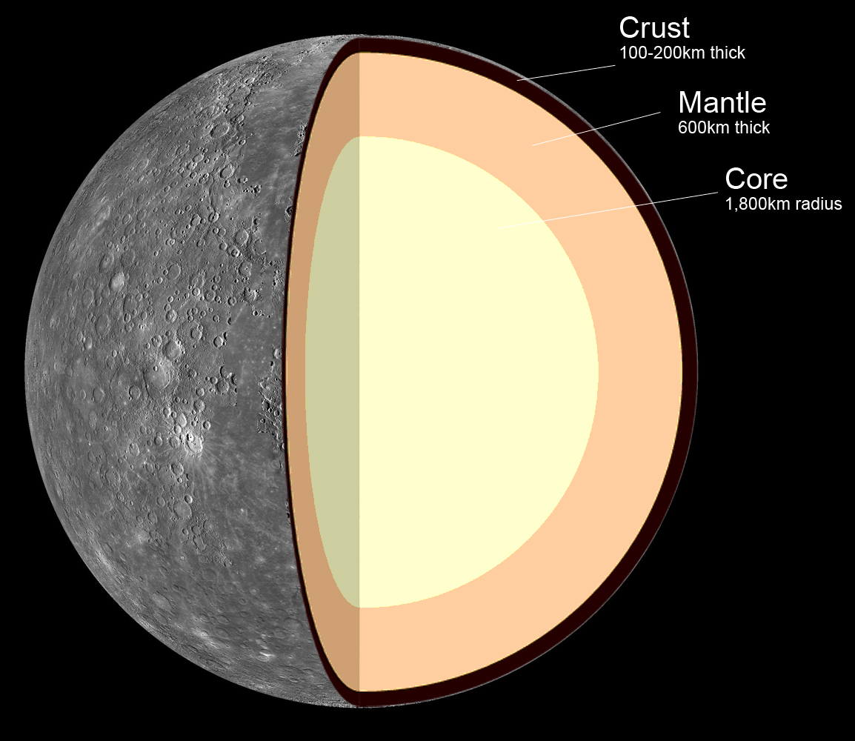
Types of Planet
The Earth-like or terrestrial planets are small and rocky.
Pictured is Mercury, the smallest planet in the solar system. It is closest to the Sun with no real atmosphere.

Slide 2
Venus
Venus is about the same size as Earth and has a very thick atmosphere.

Slide 3
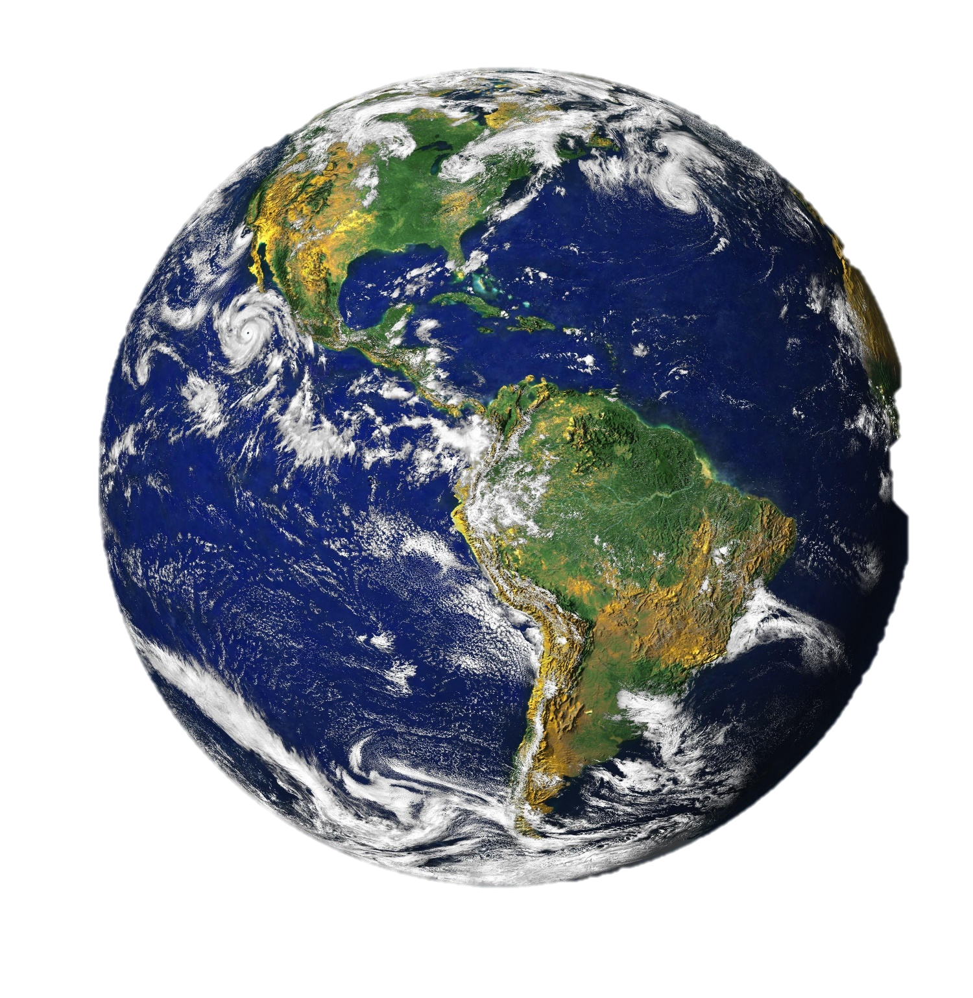
Earth
Terrestrial planet
In the “Goldilocks” zone
Contains water

Slide 4
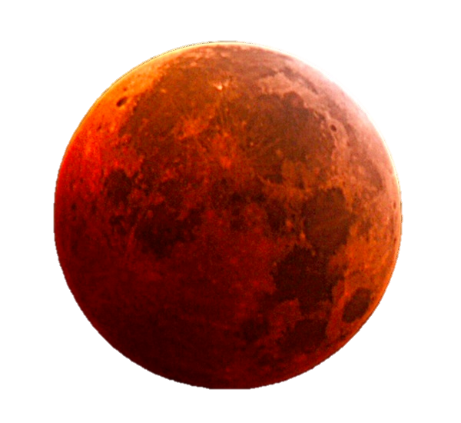
Mars
Mars is rocky, smaller than Earth with a very thin atmosphere.

