Slide 1
Energy and Life
Chapter 8.1

Slide 2
What is Energy?
Simply put energy is the ability to do work.
Nearly all activities depend on energy. For example cars need to burn gasoline, electrical appliances need electrical energy and organisms need chemical energy.
Energy can come in many forms including light, heat, and electricity.
Energy can also be stored in chemical compounds.

Slide 3
Candle Example
A candle contains compounds that contain many chemical bonds.
These chemical bonds contain energy.
As the candle is burned the chemical bonds between the carbon and the hydrogen atoms in the wax are broken.
New bonds form between these atoms and Oxygen and create new compounds (CO₂ and H₂O).
These new bonds are at a lower energy state than the original bonds as some energy was released as light and heat.

Slide 4
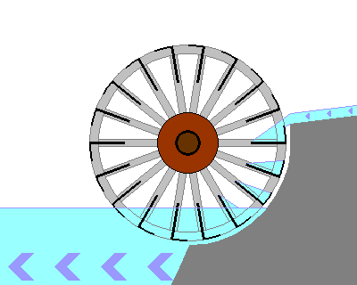
Lower Energy States

Slide 5
The Law of Conservation of Energy
The first law of thermodynamics states that energy can be neither created nor destroyed.
However, energy can change forms, and energy can flow from one place to another.
When energy changes from one form to another some energy is always released as heat or light.

Slide 6
Chemical Energy
Cells need to maintain homeostasis, grow, develop and move materials or even move around environments.
The many jobs that a cell must complete all require energy
We need to know what powers all these activities and where this energy comes from

Slide 7
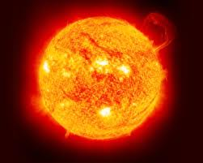
The Sun
The Sun is the ultimate source of energy on our planet

Slide 8
Heterotrophy and Autotrophy
Cells are not born with a supply of energy. Energy comes from food.
Organisms that obtain food by consuming other organisms are known as heterotrophs.
Some heterotrophs eat plans and some eat the organisms that feed off the plants.
Other types of heterotrophs feed by decomposing dead organisms and waste (i.e. bacteria and fungi).

Slide 9
Heterotrophy and Autotrophy
Originally the energy in food molecules comes from the Sun
The organisms that make their own food using this energy are known as autotrophs.
Ultimately nearly all life on earth depends on the ability of autotrophs to combine light energy and other molecules to form sugars and starches.
This process is known as photosynthesis.

Slide 10
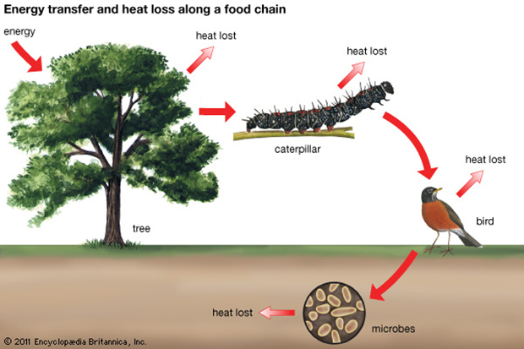
Energy Transfer

Slide 11
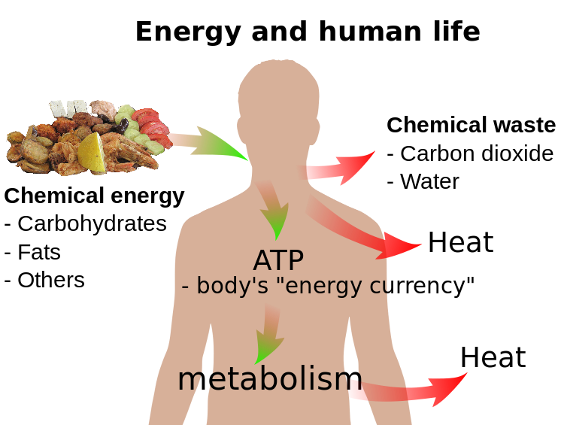
Homo sapiens and Energy

Slide 12
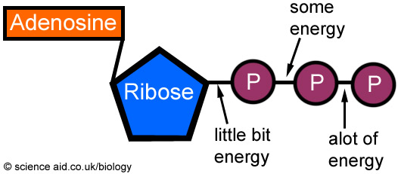
Adenosine Triphosphate
Energy in organisms is held in the form of adenosine triphosphate or ATP. ATP consists of adenine (a base) , a 5-carbon sugar called ribose and 3 phosphate groups.
Energy is released from ATP when the covalent bonds joining a phosphate group are snapped off. This leaves us with ADP + P.

Slide 13
Storing Energy
Adenosine diphosphate or ADP is a compound that looks almost like ATP except that is only has two phosphate groups.
This is the key to energy storage in cells.
When a cell has energy available it can store it by adding a phosphate group to ADP creating ATP.
ADP + Pi >>>>>>> ATP

Slide 14
Releasing Energy
Energy can be released by cells through the controlled breaking of the chemical bond between the second and third phosphate group.
This makes ATP an exceptionally useful energy source for all cells.
ATP >>>>>>> ADP + Pi + Energy

Slide 15
Using Biochemical Energy
ATP can be used to power many different tasks.
    Active transport pumps
    Protein synthesis
    Power movement – contract muscle or cilia or flagella
However most cells have only very limited stores of energy – enough for a few seconds work.
It is more efficient to store molecules such as glucose, one molecule of which contain enough energy to add a phosphate group to ADP more that 90 times.

Slide 16
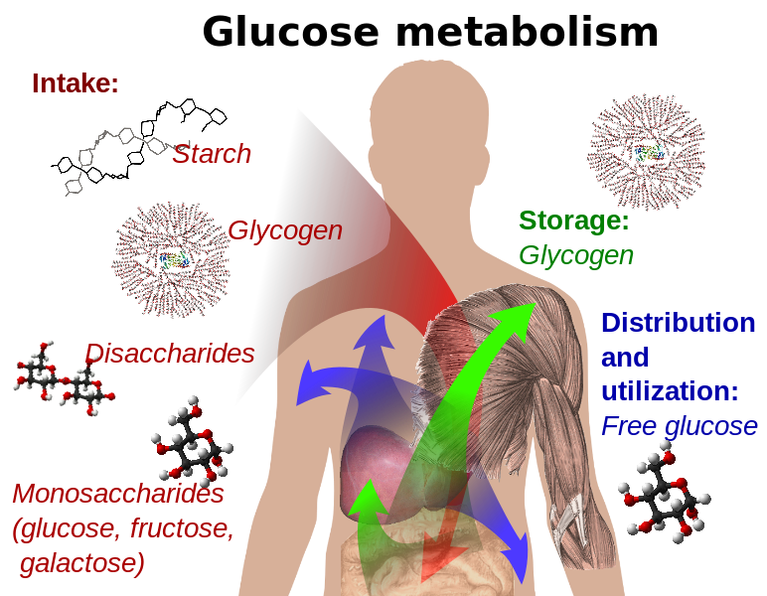
Glucose Storage

