Slide 1
Fermentation
Chapter 9.3

Slide 2
Fermentation
As we have seen autotrophs capture the Suns energy and then store it in the form of sugars.
Autotrophs and heterotrophs then release this energy by breaking down the sugars during the process of cellular respiration.
As we have seen in order to do this we need to have O₂.
But when O₂ is not available or we are working so hard that we cannot provide enough cells need a way to make some energy available.

Slide 3
Fermentation
As we have seen cellular respiration is split into 3 phases; glycolysis, Krebs Cycle, electron transport chain (ETC).
The electron transport chain needs O₂ or it cannot restore ATP. Although the Krebs Cycle does not directly need O₂ if the ETC stops the Krebs cycle cannot continue.
This means that in anaerobic conditions (without O₂) glycolysis is the only phase that can continue.

Slide 4
NAD+ and NADH
During Glycolysis high energy electron carriers are filled with H⁺ ions.
After a few seconds of glycolysis all the NAD⁺ will be used up and glycolysis will not be able to continue.
In order to continue producing ATP the cell must perform fermentation.

Slide 5
Fermentation
During fermentation NADH passes its high energy electrons back (oxidation reaction) to the end product of glycolysis – a molecule called pyruvate.
This frees up NAD⁺ which can go back and accept electrons (reduction reaction) as glucose is broken down during glycolysis.

Slide 6
The Advantages of Fermentation
The advantage of fermentation is that through glycolysis it can produce ATP very quickly.
The disadvantage is that 1 molecule of glucose yields far less ATP (Net 2 ATP from fermentation versus 36 from aerobic respiration.
Lactic acid build-up can also limit how much fermentation can occur.

Slide 7
Fermentation
Glucose
NAD+
NADH
ADP + P
ATP
If O₂ is available
Enters the Mitochondria:
Krebs Cycle
ETC frees up NAD⁺
If O2 is unavailable
NADH >>>> NAD⁺
Lactic acid
or
Ethyl Alcohol + CO₂
Pyruvate
Pyruvic Acid + NADH >>>>>>>> Lactic acid + NAD⁺
Pyruvic Acid + NADH >>>>>>>> Ethyl Alcohol + NAD⁺ + CO₂

Slide 8
Lactic Acid Fermentation
Humans are lactic acid fermenters. Many important organisms are also Lactic acid fermenters.
Products such as cheese, yogurt, buttermilk and sour cream are produced using lactic acid fermentation.

Slide 9
Alcoholic Fermentation
Alcoholic fermentation is used to produce alcoholic beverages.
It is also the process that causes bread dough to rise. Yeast cells in the dough run out of air and use fermentation to release energy.
The bubbles that you can see in dough as it ferments are CO₂. These make up the spaces in a slice of bread.

Slide 10
Fermentation and Exercise
Aerobic and anaerobic pathways have different advantages and disadvantages.
Which type of respiration do you think would be most beneficial to an athlete in a particular sport?

Slide 11
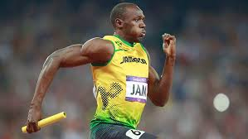
Why Do We Need Anaerobic Respiration?
Our bodies cannot supply energy fast enough for all activities.

Slide 12
Energy and Exercise
For short bursts of explosive energy or in the time it takes for your heart and lungs to catch up with the O₂ demand of your cells anaerobic pathways (fermentation) are crucial.
Exercise lasting longer than about 90 seconds cellular respiration is the only way to continue generating a supply of energy.

Slide 13
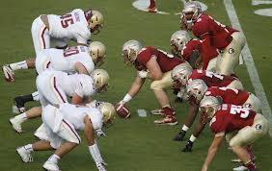
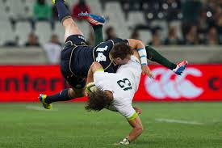
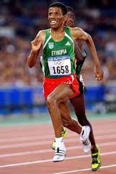
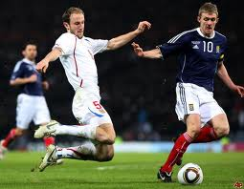
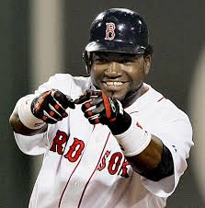
What about these sports?

Slide 14
Conclusions
During cellular respiration ATP is produced anaerobically and aerobically.
The Krebs cycle and the ETC require oxygen in order to continue. They are said to be aerobic.
Glycolysis can continue to produce ATP in the absence of oxygen (anaerobically) through the process of Fermentation.
The by-product of fermentation is either lactic acid or ethyl alcohol.

Slide 15
Chapter 8 and 9 Summary
6CO₂ + 6 H₂0 >>>>>> C₆H₁₂O₆ + 6O₂
C₆H₁₂O₆ + 6O₂ >>>>>> 6CO₂ + 6H₂O
ADP + P
ATP + HEAT

Slide 16
Cellular Respiration Summary
Glycolysis
Krebs cycle and ETC
Glucose
Anaerobic
Aerobic
6O₂ + C₆H₁₂O₆ >>>>>>>>> 6CO₂ + 6H₂O
Oxygen + Glucose >>> Carbon Dioxide + Water + Energy

