Slide 1
Gravity and Our Solar System
Mr. McLean

Slide 2
What is Gravity?
Gravity is a force exerted by masses.
When you drop an object it accelerates towards the ground.
Because it accelerates there must be a net force acting on it.

Slide 3
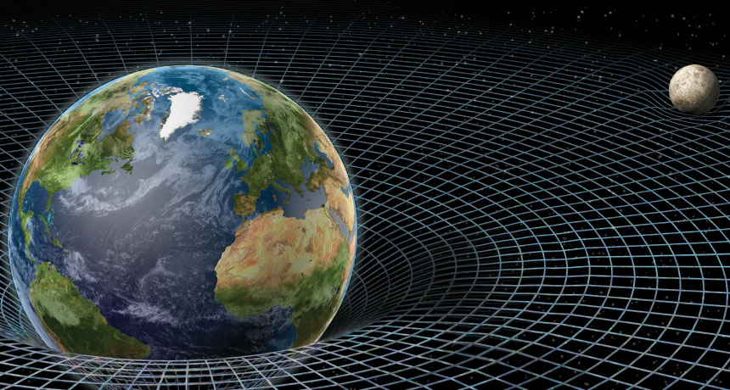
What is Gravity?
Gravity is the force that attracts a body towards the center of the Earth or to any other physical body with mass.
Newton described gravity as the attraction between two masses. Einstein described it as the bending of space and time.
Notes:
The force that attracts a body toward the center of the earth, or toward any other physical body having mass. For most purposes Newton's laws of gravity apply, with minor modifications to take the general theory of relativity into account.

Slide 4
Masses Attract Each Other
Gravity is considered a universal force. It is present between any two bodies with mass.
There is a gravitational attraction between the Earth and the moon, but also between the Sun and the Earth.
Even though the Sun is much bigger it is much further away so its pull is about ½ that of the Moon.

Slide 5
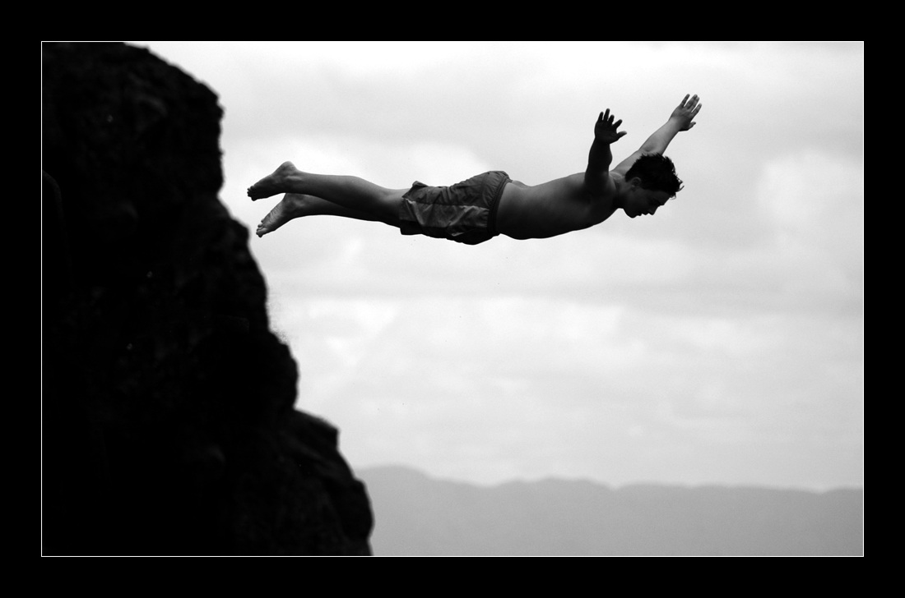
What is pulling on what?

Slide 6
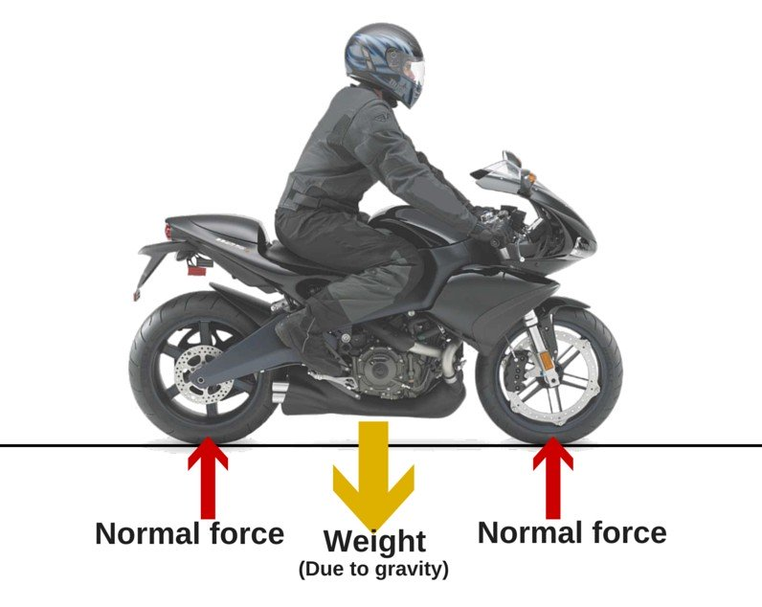
What does gravity feel like?
Since Newton’s 3rd law of motion tells us that every action has an equal and opposite reaction what we feel is the opposite force to gravity.
This is known as the support force or normal force.

Slide 7
Gravity – The Basics.
The force of gravity is measured from an objects center of mass.
Bigger masses result in greater gravitational pulls.
The force of gravity weakens the further you move away from an object.

Slide 8
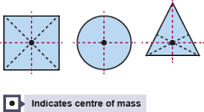
Center of Mass
A point representing the mean position of the matter in a body or system.

Slide 9
Review: Weight and Mass

Slide 10
Force of Gravity
Mars 3.711 m/s²
Earth 9.807 m/s²
Jupiter 24.79 m/s²

Slide 11
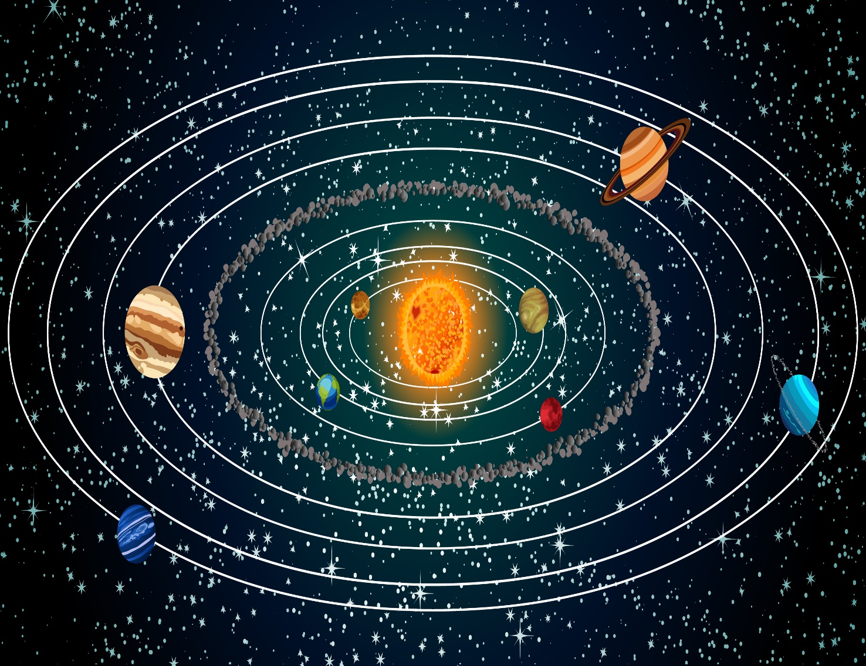
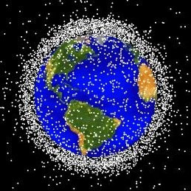
Gravity Keeps Objects in Orbit.

Slide 12
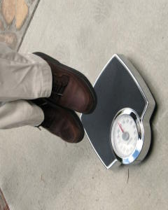
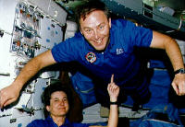
Weightlessness?

Slide 13
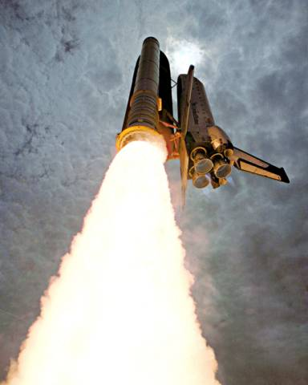
Escape Velocity
Planets exert a large force on objects close to them.
The space shuttle needs to overcome this force in order to escape the Earths gravitational pull.
In order to do this it must accelerate to the escape velocity (11.2 km/s).
Notes:
The shuttle must must reach a velocity of about 11.2 km/s

Slide 14
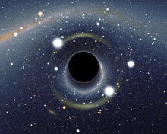
Black Holes
A black hole is a region of space-time exhibiting such strong gravitational effects that nothing can escape from inside it.
Not even particles and electromagnetic radiation such as light will be immune to its effects.
Notes:
The theory of general relativity predicts that a sufficiently compact mass can deform spacetime to form ablack hole

Slide 15
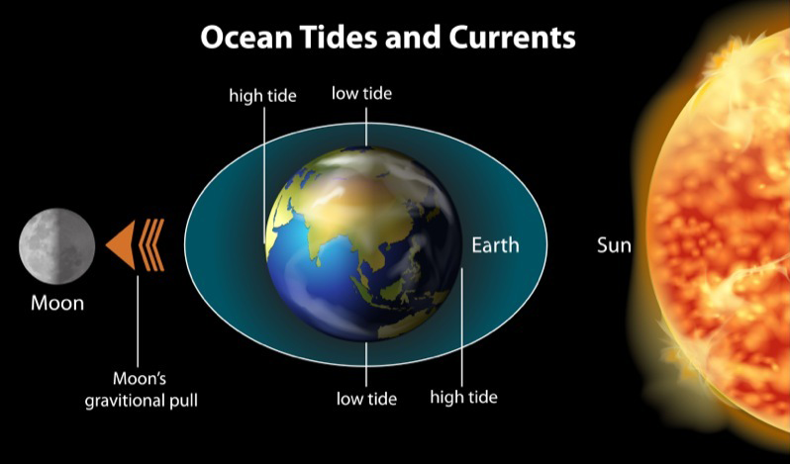
Gravity and the Tides

Slide 16
Gravity and Tides

Slide 18
Spring tides: Extreme high and low tides
Notes:
When the gravitational pull of the sun and moon are combined, you get more extreme high and low tides. This explains high and low tides that happen about every two weeks.

Slide 19
Neap tides: Least difference between high and low

Slide 20
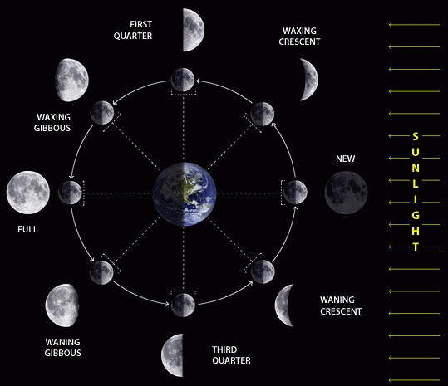
New and Full Moon’s
It takes 27 days, 11 hours, 43 mins, and 11.6 seconds for the Moon to orbit the Earth.
As it does so light from the Sun will hit the Moon at different angles.
The Moon will appear to wax (grow bigger) and wane (grow smaller).
Notes:
It takes 29–30 days. The moon completes its orbit around the earth in 27.3 days (the sidereal month), but due to the Earth's motion around the sun it has not finished a full (synodic) cycle until it reaches the point in its orbit where the sun is in the same position.

Slide 21
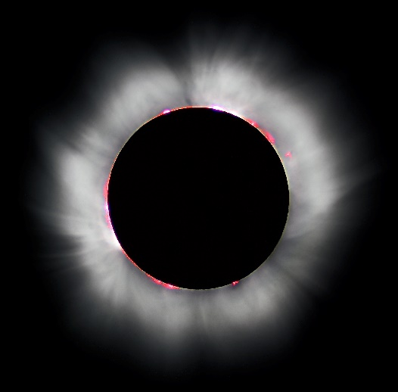
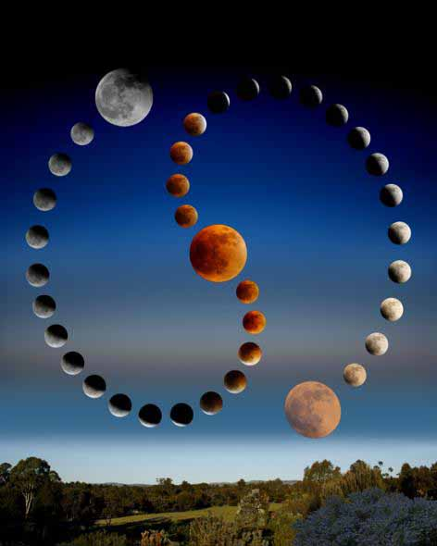
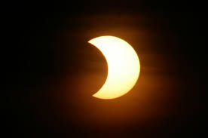
Eclipses
A total solar eclipse is a cosmic coincidence with stunning visual effects for viewers on Earth.
When the moon passes in front of the sun and blocks it completely, it casts a shadow onto our planet that plunges areas into a darkness.

Slide 22
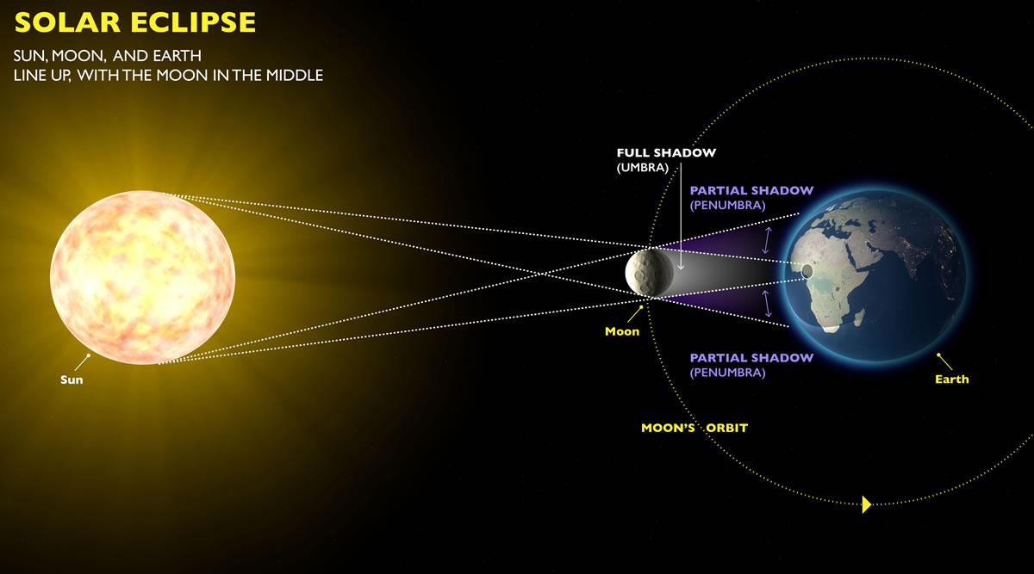

Slide 23
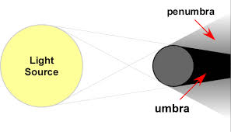
Umbra
Umbra - The darkest shadow cast by the Moon where the light from the Sun will be completely blocked.
Penumbra – The lighter but larger shadow cast by the Moon.

Slide 24
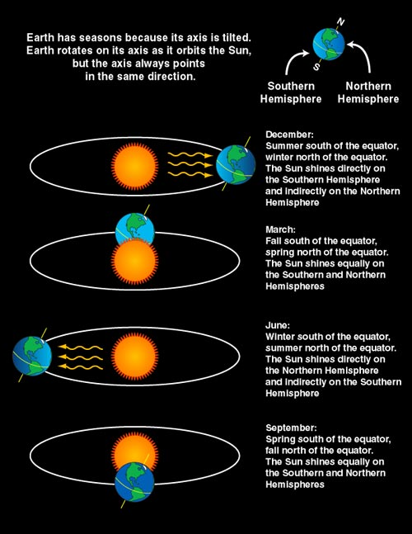
The Earth’s Seasons
The Earth has distinct seasons.
These are caused by the fact the Earth is tilted by 23.5º.
Because of this the overhead Sun appears to change position as the Earth orbits around the Sun over a period of 365 days.

Slide 25
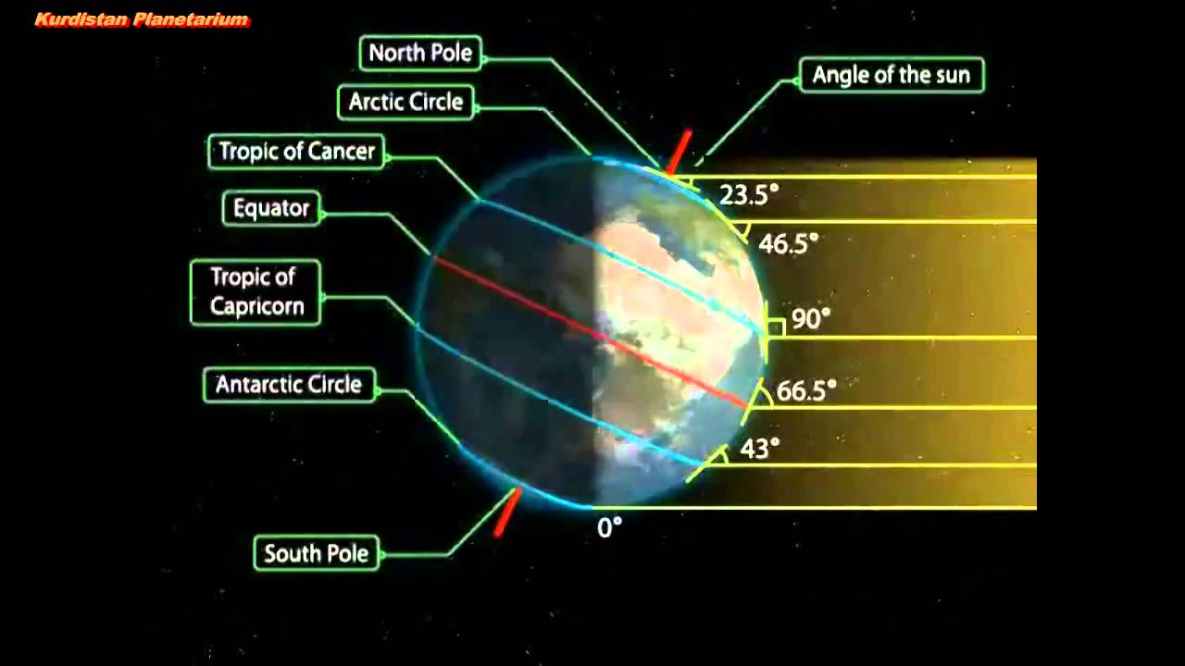

Slide 26
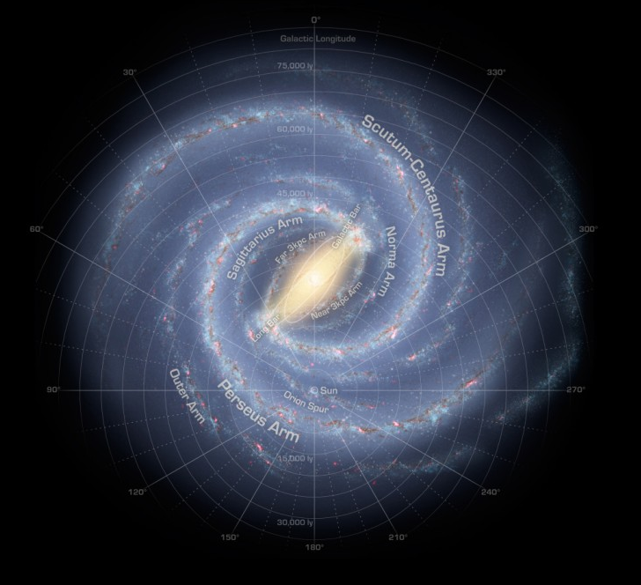
What does the Sun orbit around?
The Sun orbits around the center of the galaxy.
It takes the Sun around 230 million years to make one complete orbit.
The Milky way is a spiral galaxy and in the center there is a giant black hole.
Notes:
Yes, the Sun - in fact, our whole solar system - orbits around the center of the Milky Way Galaxy. We are moving at an average velocity of 828,000 km/hr. But even at that high rate, it still takes us about 230 million years to make one complete orbit around the Milky Way! The Milky Way is a spiral galaxy.

