Slide 1
Diversity of Cellular Life, Homeostasis, and Cell Communication
Section 7.4

Slide 2
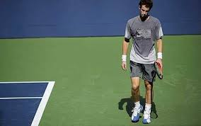
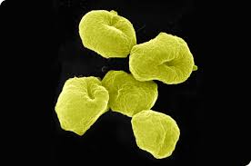
Life on Earth
Life on Earth extends to many varied and challenging environments. Habitats range from deep with the soil to deep under the sea.
All living things are made from cells and share the same basic chemistry.
We can even see many organisms sharing the same organelles.
All organisms need a method of maintaining their bodies at relatively stable conditions.

Slide 3
3 Domains and 6 Kingdoms of Life
Life on earth can be classified in many complex systems but the most common way is to use 3 Domains sub-divided into 6 broad kingdoms of organism.
The 3 domains we refer to are; Bacteria, archaea, and eukariota .
The 6 Kingdoms are; Animals, plants, fungi, protists, eubacteria, and archaebacteria.

Slide 4
3 Domains

Slide 5
6 Kingdoms of Life

Slide 6
Characteristics of Organisms

Slide 7
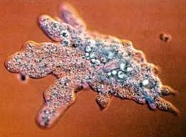
The Cell as an Organism
Individual cells need to maintain their homeostasis.
Unicellular organisms dominate life on Earth in terms of their sheer numbers.
Unicellular organisms need to grow, respond to their environment, transform energy and reproduce.

Slide 8
Multicellular Life
The cells of multicellular organisms work together to maintain homeostasis.
The cells of multicellular organisms become specialized for particular tasks and communicate with one another to maintain homeostasis.

Slide 9
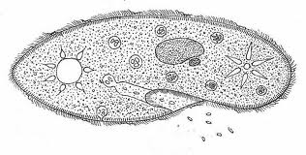
Homeostasis
From the Greek word Hómoios – similar, and the word stásis – standing still, Homeostasis means the property of a system to regulate its internal environment and remain stable.

Slide 10
Feedback Loops
Most cells in our body operate on a negative feedback loop.
This is the same way a thermostat will work.
As the temp drops the thermostat triggers the boiler to turn on and the heat rises. Once it rises to a set point the boiler will shut off and the heat will drop again.

Slide 11
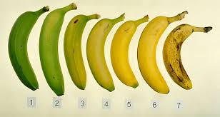
Positive Feedback
The less common type of feedback is positive feedback.
Positive feedback goes in one direction away from a set point.
For example ripening bananas give of a hormone called ethylene. This causes neighboring bananas to release their ethylene and soon all the bananas on the tree will be ripe.

Slide 12
Cell Specialization
The cells of a multi-cellular organism are all specialized for particular roles.
For example some aid in movement, some react to the environment and others produce substances needed by the organism.
All cells in a multi-cellular organisms contribute to the homeostasis of the organism.

Slide 13
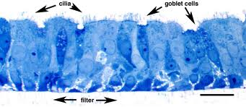
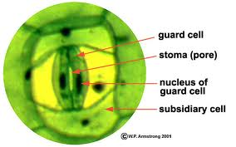
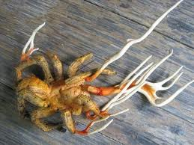
Specialized Plant and Animal Cells
Human Trachea Epithelium cells
Human Liver Cell
Honey Fungus - mycelium
Leaf Guard Cell

Slide 14
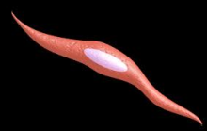
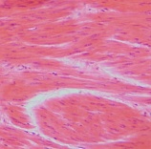
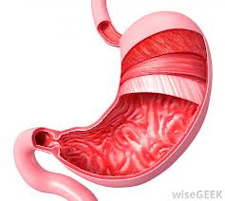
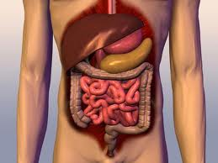
Levels of organization
Cell >>> Tissue>>> Organ>>> Organ System
Many tasks are too complicated to be carried out by just one type of tissue.
For example within a muscle we have muscle tissue but we also have nervous tissue and connective tissue.

Slide 15
Cellular Communication
Cells in a large organism communicate via chemical signals passed from one cell to another.
These signals can change the rate that cells are performing activities and can thus cause dramatic effects in cells.
Via this communication cells can establish homeostasis.

Slide 16
Cellular Junctions
Cells within a tissue are connected to one another via cellular junctions
Some of these junctions hold cells tightly together.
Others allow small molecules to pass through that carry chemical signals to other adjacent cell.
The cell receiving this signal must have an appropriate receptor that the signaling molecule can bind to (located on the cell membrane or in the cytoplasm.

Slide 17
Types of Junction
Allow Cellular communication
Anchor the cell
Anchor tissue

Slide 18
Types of Cell Communication

Slide 19
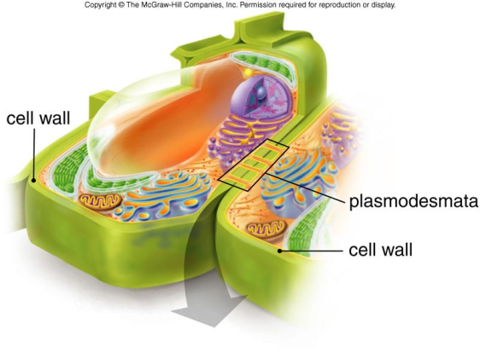
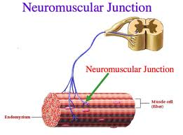
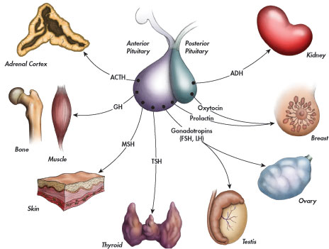
Cell Communication
No distance
Short distance
Cell to cell
Long distance
Hormones – Affect many cells

