Slide 1
Introduction to Genetics
Chapter 11.1

Slide 2
Heredity and Genetics
Most of us are familiar with the concept of inheritance.
People will often write a will dictating where or to whom their money or property will be left.
However we have all inherited our physical characteristics and behaviors from our parents.
Our genes determine whether we are short or tall blue eyed or brown.
The delivery of characteristics from parents to offspring is known as heredity and the scientific study of heredity is known as genetics.

Slide 3
A theory of inheritance must explain the following;
All living things arise from pre-existing things.
Offspring of 2 parents usually resemble the parents
Many traits in the offspring are not exactly like those of either parent.
Herdity – passing on of characteristics from parents to offspring

Slide 4
The Work of Gregor Mendel
The modern study of genetics was founded by an Austrian monk named Gregor Mendel in 1822.
After becoming a monk Mendel spend several years at the University of Vienna and then the next 14 years teaching at a monastery high school.
In addition Mendel was placed in charge of the monastery garden. It was in this simple monastery garden that Mendel changed biology forever

Slide 5
The Work of Gregor Mendel
Mendel carried out a series of experiments on pea plants that taught as a lot about the way genetic information is passed from one generation to the next.
Pea plants are simple organisms that scientists term a “model system”. That is they are convenient to study and suggest to us ways that other organisms (including humans) may behave.
The experiments carried out by Mendel would have taken 100s of years to perform on larger organisms such as mammals.

Slide 6
The Role of Fertilization
Mendel knew that the male part of each flower makes pollen which contains the male reproductive cells or gametes (sperm).
The female portion of each plant produces the reproductive cells called eggs.
During sexual reproduction the male and female cells combine in a process known as fertilization, producing a new cell called a zygote.
The cell then develops into an embryo encased within a seed.

Slide 7
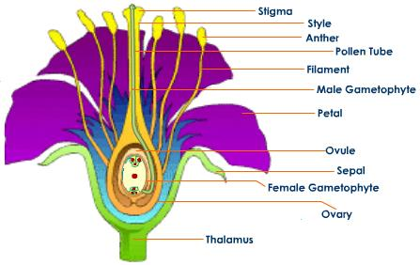
Plant Anatomy

Slide 8
The Work of Gregor Mendel
Pea plants are normally self pollinating.
This means that a plant joins its own sperm and egg cells together to make an offspring. It has a single parent.
Mendel’s garden had stocks of several “true breeding” pea plants. These plants would produce offspring identical to themselves
The traits of each successive generation would be the same. A trait is a specific characteristic such as seed color or plant height.
Mendel’s stocks varied from each other. For example one stock produced only tall plants another produced only short plants. One line produced only green seeds another produced only yellow seeds.

Slide 9
The Work of Gregor Mendel
To find out how these traits were determined Mendel decided to “cross” his stocks of pea plants.
That is he decided to make one plant type reproduce with another plant type.
He did this by cutting the pollen bearing part of the flower off and dusting the female part with pollen from a different plant type.
This process is known as “cross pollination” and produces a plant that has two parents.
This process allowed Mendel to produce plants that had traits different from their parents.

Slide 10
The Work of Gregor Mendel
Mendel studied 7 different traits in pea plants.
He crossed plants with each of the 7 different characteristics and studied their offspring.
The resulting offspring from parent with different traits are known as hybrids.

Slide 11
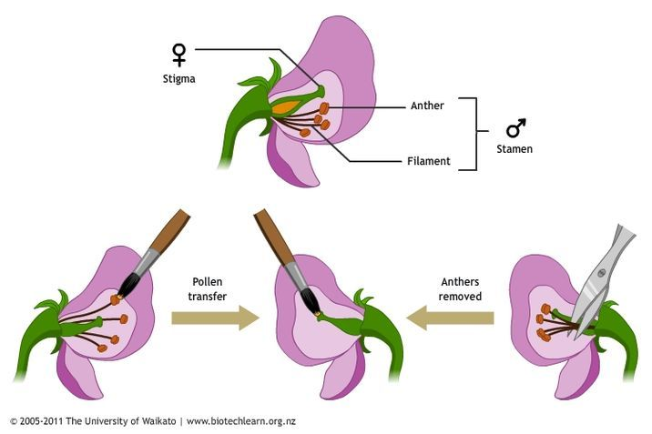
Cross Fertilization

Slide 12
Genes and Alleles
When doing genetic crosses we call each original pair of plants the P or parental generation.
Their offspring are called the F₁ or first filial generation (filius and fila are Latin for son and daughter).
To Mendel’s surprise all of his hybrid plants had the characteristics of only one of the parents.
He concluded that: An individuals characteristics are determined by factors that are passed from one parental generation to the next.

Slide 13
Genes and Alleles
Today scientists term the factors that are passed from one parent to offspring genes.
Each of the traits that Mendel studied was controlled by one gene that occurred in two contrasting varieties.
These variations produced different expressions or forms of each trait.
For example the gene for plant height occurred in two forms. One produced tall plants and the other produced short plants. The different forms of each gene are called alleles (uh LEELZ).

Slide 14
Dominant and Recessive Traits
Mendel’s second conclusion was the principle of dominance.
This principle states that some alleles are dominant and some are recessive.
An organisms with at least one dominant allele for a particular form of a trait will exhibit that form of the trait.
An organism with a recessive allele for a particular trait will not exhibit that trait if the dominant form is present.
In Mendel’s experiments the allele for tall plants was dominant to the allele for short plants and the allele for yellow seeds was dominant over the recessive allele for green seeds.

Slide 15
Segregation
Mendel didn’t stop after the F₁ generation. He wanted to know if the recessive alleles were still present or had they simply disappeared.
To answer this he allowed the F₁ generation to self-pollinate. Effectively crossing the F₁ with itself.
The next generation are known as the F₂ generation (second filial).

Slide 16
The F₁ Cross
When Mendel compared the F₂ plants he made a remarkable discovery.
The traits controlled by recessive alleles had reappeared in the F₂ generation.
Roughly ¼ of the F₂ plants showed traits controlled by recessive alleles.
Why did the recessive alleles disappear in the F₁ generation only to reappear in the F₂ generation?

Slide 17
Exploring the F₁ Cross
Mendel assumed that the dominant alleles masked the recessive alleles.
When answering the question as to why the recessive alleles reappeared in the F₂ generation, Mendel suggested that the dominant and recessive alleles must have segregated during the formation of sex cells.
Sex cells (sperm and eggs) are known as gametes.

Slide 18
The Formation of Gametes
The F₁ plants would have inherited the allele for tallness from one parent and the allele for shortness from the other.
Because the allele for tallness is dominant over the allele for shortness all of the F₁ generation would have been tall.
During the formation of gametes the alleles for each gene segregate from each other so that each gamete carries only one type of allele for each gene.
Thus each plant would produce two types of gamete; those with the tall allele and those with the short allele.

Slide 19
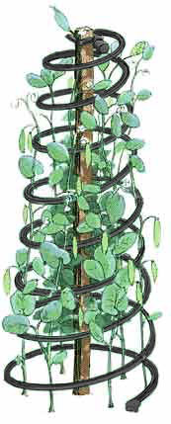
Segregation
TT
tt
T
T
t
t
Tt
Tt
Tt
Tt
T
t
T
t
T
T
t
T
t
T
t
t

Slide 20
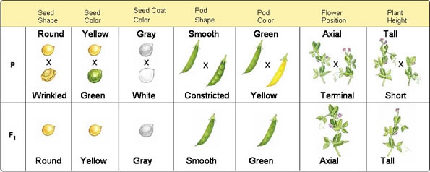
Mendel’s Pea Plant Crosses

