Slide 1
Cell Structure and Function
Chapter 7

Slide 2
7.1 Life is Cellular
Cell Theory – one of the unifying theories of science
All living things are made of cells
The cell is the basic unit of life – the smallest functional part that is actually considered alive.
New cells are produced from existing cells – cells reproduce by meiosis and mitosis

Slide 3
Microscopy
The invention of microscopes transformed our understanding of the world and paved the way for the development of cell theory
Remember – what do we mean in science when we say something is a theory?

Slide 4
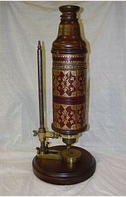
Robert Hooke
In the early 1600s eyeglass makers started to use several lenses to magnify very small objects
In 1665 Englishman Robert Hooke used one of these early microscopes to look at a think slice of cork
He observed many small compartments which he likened to the cells in a monastery. The term cell is still used today.
Anton van Leeuwenhoek
Used an early microscope to examine pond water.
He was amazed to see many small organisms both in the water and in saliva samples from his own mouth – we now know that these are called bacteria.

Slide 5
Modern Microscopes

Slide 6
Light Microscopes
Allows light to pass through a specimen
Magnifies it using 2 lenses
Light waves can be diffracted so this limits the extent to which slides can be magnified
Typically magnifies up to about 1000 times the actual size (about 1 000 000th of a meter)
Usually combined with dyes to make images clear (most cells are nearly transparent)

Slide 7
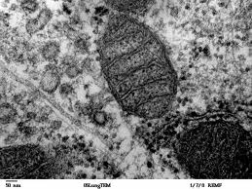
Electron Microscopes
Much of what scientists want to study is far smaller than the images produced by a light microscope – for example organelles and substances such as DNA
Electron microscopes work by using beams of electrons and magnetic fields to produce images that enable scientists to see
TEM - ultra thin slices of a substance are observed. Makes it possible to see organelles and even individual molecules
Transmission Electron Microscope – TEM

Slide 8
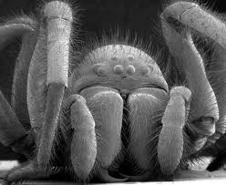
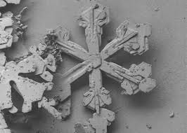
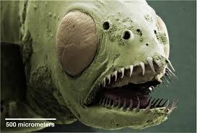
Scanning Electron Microscope (SEM)
SEM – electrons are scanned over the surface of an object.
Electrons do not display color so this is digitally added later
Both TEM and SEM require the specimen to be chemically preserved and in a vacuum. Therefore neither can be used on living samples
Scanning Electron Microscope – SEM

Slide 9
Food Under the Microscope
Blueberry
Strawberry
Tomato
Broccoli

Slide 10
Toothbrush Bristle

Slide 11
Magnification of Microscopes

Slide 12
Metric Prefixes
Metric prefixes in everyday use
Text | Symbol | Factor
tera | T | 1 000 000 000 000
giga | G | 1 000 000 000
mega | M | 1 000 000
kilo | k | 1 000
hecto | h | 100
(none) | (none) | 1
deci | d | 0.1
centi | c | 0.01
milli | m | 0.001
micro | μ | 0.000 001
nano | n | 0.000 000 001
pico | p | 0.000 000 000 001

Slide 13
Types of Cell

Slide 14
Age of the Earth
The Earth is about 4.55 Billion years old. We know this as we have been able to date the age of the solar system through analysis of meteorites.
This was an important discovery as it allowed enough evolutionary time (sometimes called deep time) for Darwin’s theory of evolution to make sense.

Slide 15
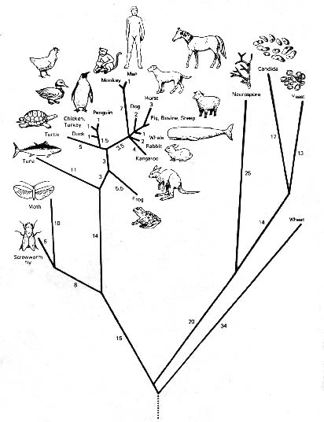
Phylogenic Tree of Life
LUCA

Slide 16
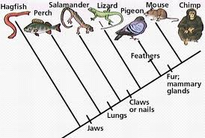
Cladograms
Cladograms place species in a logical order based on their similarities and represent a hypothesis about their evolutionary relationships to one another.

Slide 17
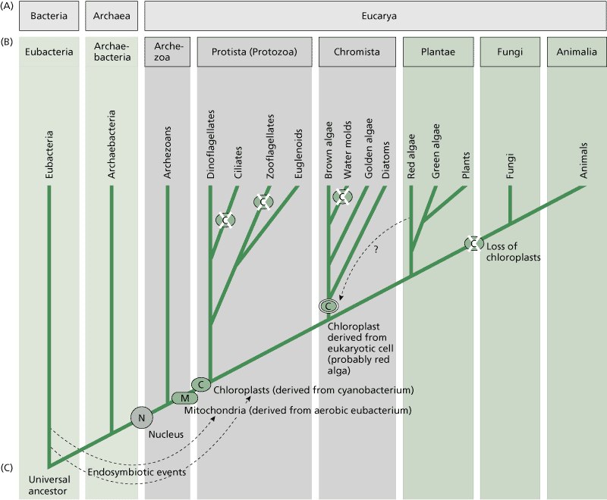
Classification of Cell Types

Slide 18
Prokaryotes and Eukaryotes
All cells are surrounded by a cell membrane (sometimes called a plasma membrane). There are two different types of cell and they vary in many ways.
Prokaryotes
Eukaryotes

Slide 19
Eukaryotes
Usually bigger and more complex than prokaryotic cells
Contain many internal membranes
Many are highly specialized with diverse metabolisms (autotrophs – food producers)
Nucleus separates the genetic material from the rest of the cell
Most eukaryotes contain many membrane bound organelles
Some form unicellular organisms but many make up large complex multi-cell organisms e.g. humans
DNA separated into many chromosomes
DNA contains introns – non-coding DNA
Cytoskeleton - gives structure to the inside of the Eukaryotic cells

Slide 20
Prokaryotes – Bacteria and Archaea
Usually smaller than the more complex eukaryotic cells with less complex metabolism (heterotrophs - consumers)
Do not separate genetic material into a nucleus
Linear loop of DNA – single chromosome
Bacteria Cell wall contains peptidoglycan. Archaea do not.
Archaea have branched hydrocarbons in the cell membrane that sometimes forms a monolayer.
Grow, reproduce, respond to environment, locomotive
less complex cytoskeleton

Slide 21
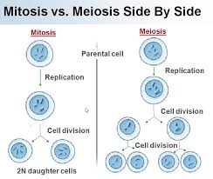
Eukaryotic Reproduction
Asexual – Mitosis Sexual – Meiosis

Slide 22
Prokaryotic Reproduction
Prokaryotic cells reproduce by a process called binary fission. The DNA in prokaryotic a linear loop located in the cytoplasm.
The reproductive process starts with the replication of this DNA.
The new chromosome attaches itself to the plasma membrane and the two chromosomes migrate to opposite ends of the cell.
The plasma membrane in the middle of the cell grows inward until it closes to separate the cell into two compartments, each with a full complement of genetic material.
The cell then "fissions" at the center, forming two new daughter cells.

Slide 23
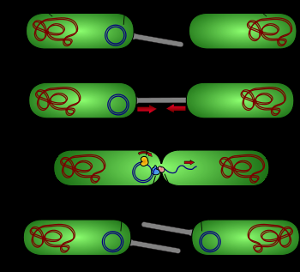
Bacterial Conjugation
Sometimes bacteria will exchange DNA in the form of small plasmids.
Two bacterial cells will join together with the help of a pilus
Their cell membranes will temporarily join and enzymes will copy the plasmid and transfer it to the other cell
The two cells will detach

Slide 24
How did cells become more complex?

Slide 25
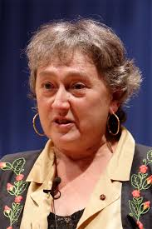
Endosymbiotic Theory
Cells became more complex by ingesting smaller cell and forming symbiotic relationships.
Evidence for this can be seen in Mitochondria and chloroplasts which contain their own DNA and resemble bacteria
Dr Lyn Margulis 1967

Slide 26
Endomembrane System
Cells can also become more complex by in-folding.
We can see evidence for this theory as the proteins on the inside and outside of the main cell membrane mirror those found in the endomembrane system.

