Slide 1
Mass vs Weight

Slide 2
Mass
Mass is the amount of matter an object contains.
Matter is anything that has mass and takes up space

Slide 3
Gravity
Gravity is the force exerted on an objects mass by another object with mass in the universe.
On Earth this is the gravitational attraction towards the Earths center.

Slide 4
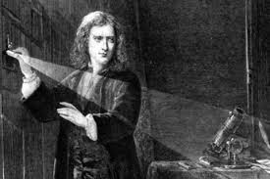
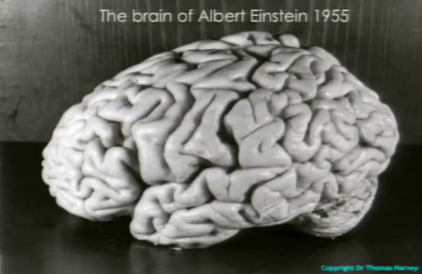
Isaac Newton
Isaac Newton defined gravity as a force.
Albert Einstein said that gravity was due to the curvature of space-time.

Slide 5
Weight
Weight is the net force that is exerted on an object due to gravity
The S.I. unit of measurement for weight is the Newton.
One newton is the force needed to accelerate one kilogram of mass at the rate of one meter per second squared

Slide 6
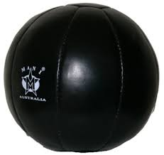
Why do objects fall at the same rate?
Describe the gravitational forces acting on these balls.
Why do they fall at the same rate?

Slide 7
What makes a car difficult to push?
Mass or weight?

Slide 8
Inertia
Inertia is the property of an object that makes it hard to start to move or stop moving.
We will learn more about it later in the year.
Inertia is the resistance of any physical object to any change in its state of motion, including changes to its speed and direction. It is the tendency of objects to keep moving in a straight line at constant velocity.

Slide 9
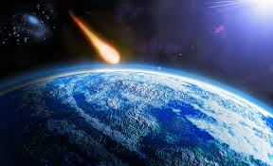
Based on your knowledge of mass and gravity
what is happening here?

Slide 10
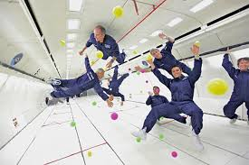
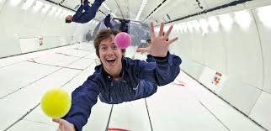
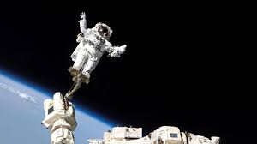
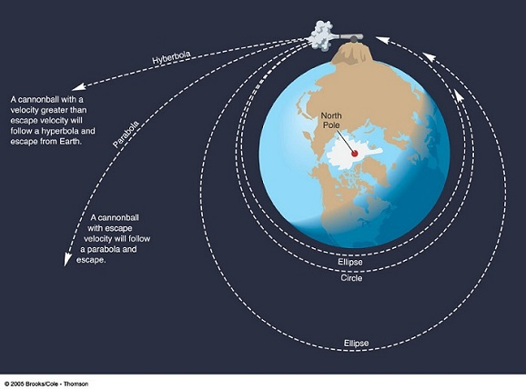
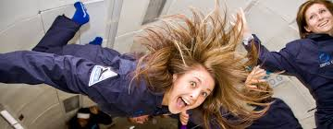
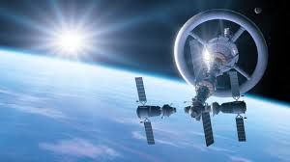
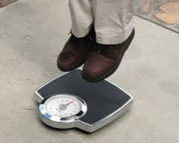
Is it possible to be in zero gravity?

