Slide 1
MCAS Open Response Questions

Slide 2
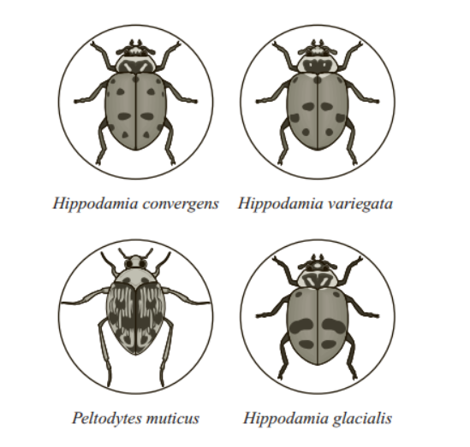
A student is studying four beetles, pictured below. Three of the beetles belong to the same genus, and one does not.
A)) Identify whether Hippodamia convergens and Hippodamia variegata can mate and produce fertile offspring. Explain your answer.
B) Which of the beetles must belong to the same family? Explain your answer.
C) Describe two types of evidence, other than mating and producing fertile offspring, that scientists can use to determine taxonomic classification and relationships among insects. Explain how each type of evidence is used.

Slide 3
Suppose a fire burns through the beetles’ habitat, leaving the trees, soil, and some rocks charred black for several years. Most of the beetles and their predators survive the fire and continue to live in the habitat.
A) Identify which beetle phenotype or phenotypes will most likely be favored in the habitat after the fire. Explain your answer.
B) Identify the type of natural selection (directional, stabilizing, or disruptive) that will most likely act on the beetle population.
The type of natural selection you identified in part (b) will change the phenotype distribution in the beetle population.
C) Using your knowledge of natural selection, explain how the change in phenotype distribution will occur.

Slide 4
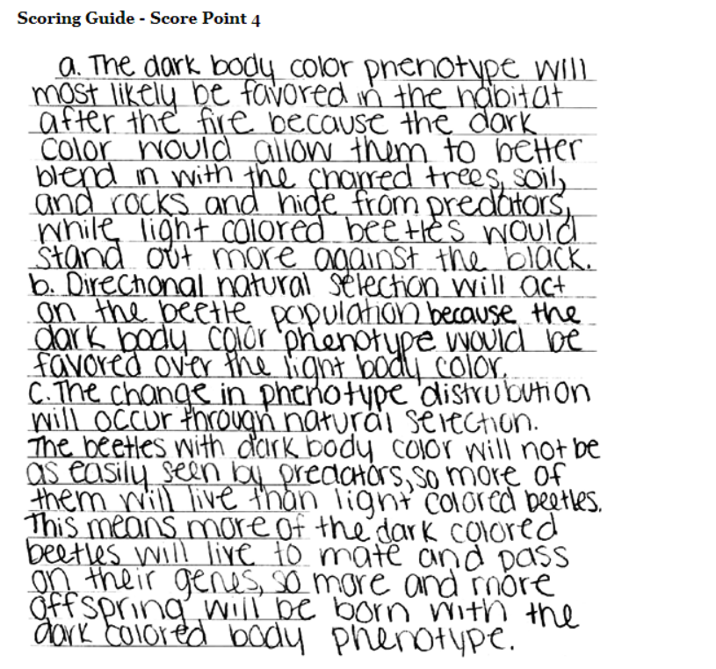

Slide 5
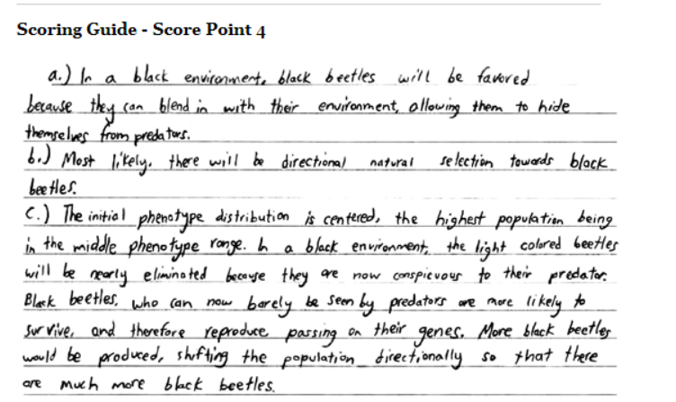

Slide 7
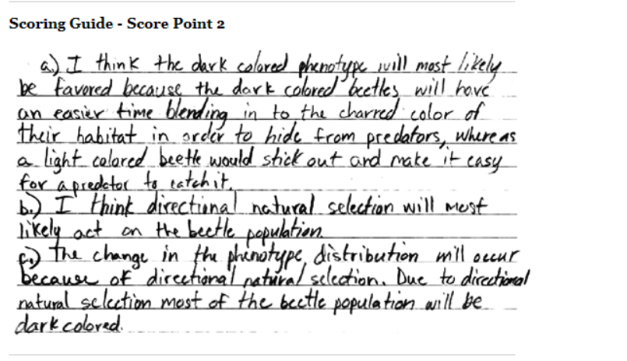

Slide 8
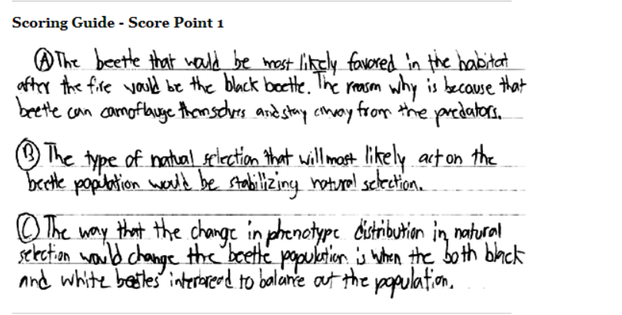

Slide 9
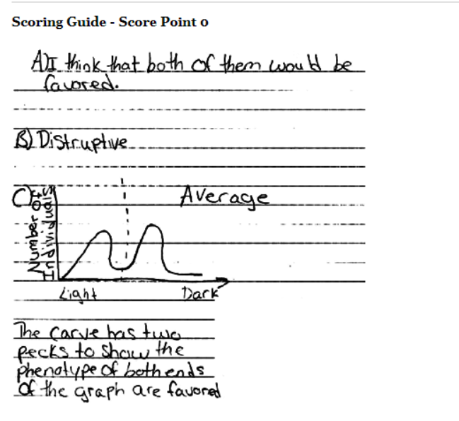

Slide 10
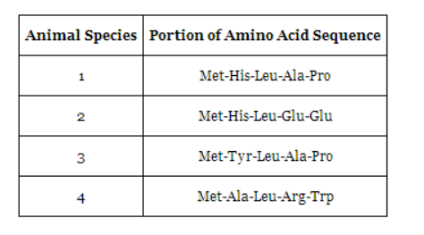
The table below shows small portions of the amino acid sequences of a particular protein in four animal species.
Based on the data in the table, which two species are most closely related? Explain your answer.
B) Describe and explain three other forms of scientific evidence that could be used to study the relatedness of these four animal species.

Slide 11
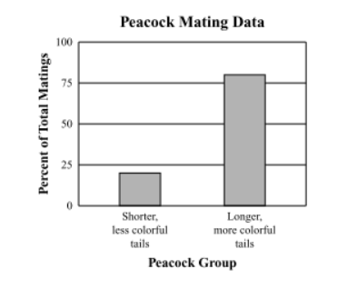
Male peafowl, called peacocks, have long, colorful tail feathers. Among peacocks there is variation in the size, brightness, and pattern of the tail. Scientists observed the mating success of two groups of peacocks. The graph below shows the scientists’ data.
A) Explain what the data show about the advantage of longer, more colorful tails for peacocks.
B) Identify one disadvantage that longer, more colorful tails have for peacocks.
C) Explain in detail how the longer, more colorful tails evolved in peacocks despite causing disadvantages for the males.

Slide 12
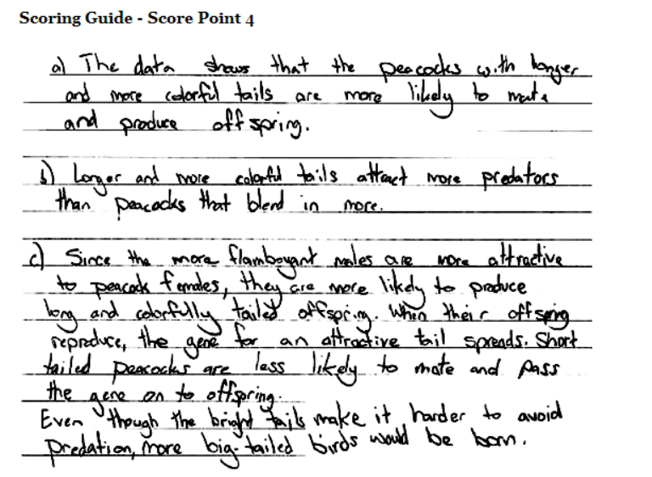

Slide 13
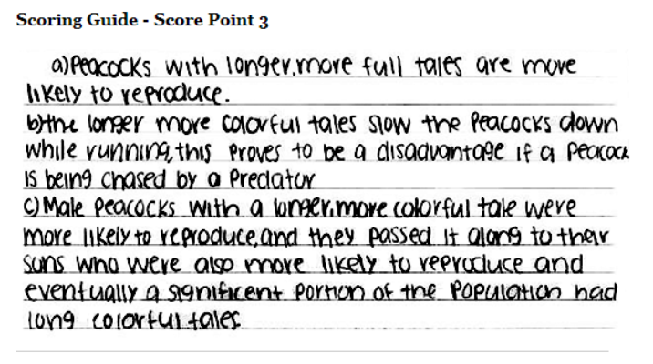

Slide 14
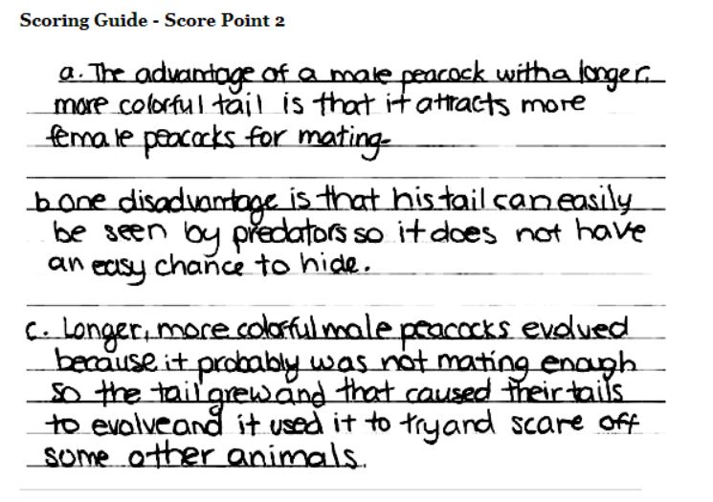

Slide 15
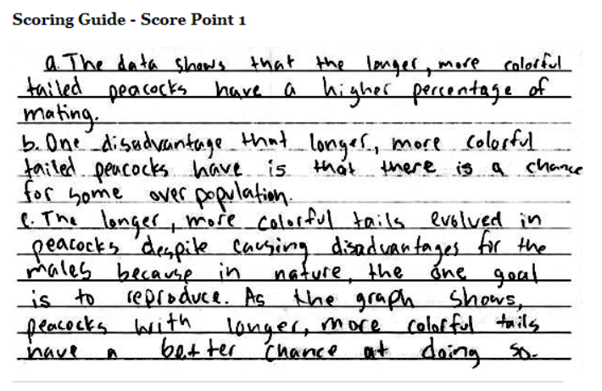

Slide 16
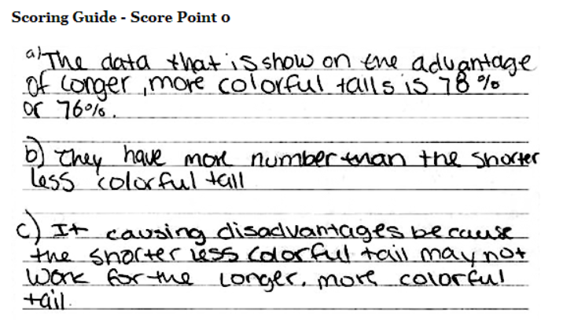

Slide 17
The table below lists the ecological roles of several organisms in a desert ecosystem.
Organism | Ecological Role
cactus | producer
cricket | primary consumer
lizard | secondary consumer
rat | primary consumer
snake | secondary consumer
yucca | producer

Slide 18
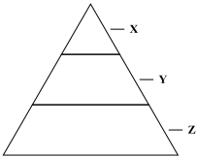
An energy pyramid shows how energy flows between different groups of organisms in an ecosystem. An incomplete energy pyramid is shown below.

Slide 19
Copy the energy pyramid into your Student Answer Booklet. Fill in the pyramid with the desert organism(s) that belong in each level. Be sure to include all six desert organisms from the table in your pyramid.
Describe the roles of primary consumers and secondary consumers in all ecosystems.
Is there more energy available for organisms in the top level of the pyramid (X) or the bottom level of the pyramid (Z)? Explain your answer.

Slide 20
The Carbon Cycle
The trees in tropical rain forests are important to nutrient cycling in the biosphere. Describe one role of the trees in the carbon cycle.
Describe one role of the trees in the oxygen cycle.
Describe one role of the trees in the water cycle.
Some rain forest trees are destroyed by burning, while some others are cut down and left on the forest floor. Describe one way that burning rain forest trees affects nutrient cycling differently than cutting them down and leaving them on the forest floor.

Slide 21
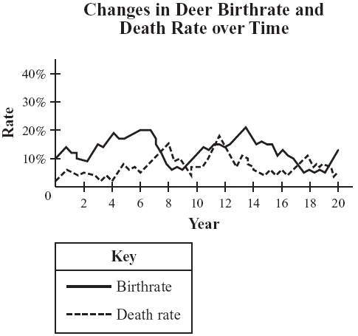
The graph below shows changes in the birthrate and death rate for a large population of deer over a 20-year study period.

Slide 22
Describe and explain two factors that can affect the birthrate in the deer population.
Describe and explain two factors that can affect the death rate in the deer population.
Identify one time period on the graph during which the deer population was increasing. Explain your answer.

Slide 23
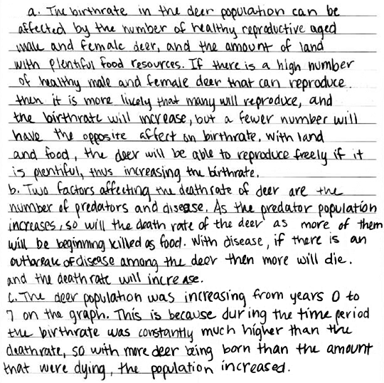
4 points

Slide 24
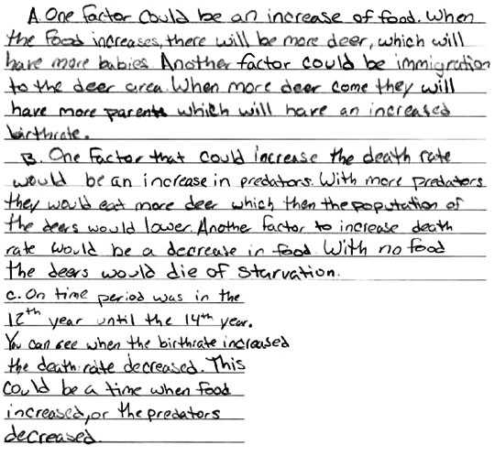
3 points

Slide 25
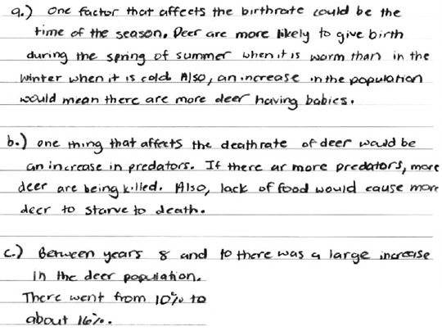
2 points

Slide 26
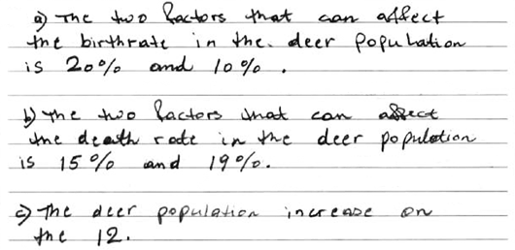

Slide 27
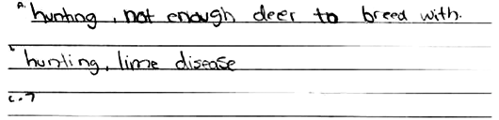
coring Guide - Score Point 1

Slide 28
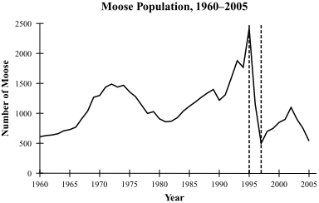
Lake Superior is on the northern border of the continental United States. The graph below shows changes in the size of the moose population on an island in Lake Superior from 1960 to 2005. The island is in a remote location several miles off the northwest shore of the lake.

Slide 29
A. Explain why immigration and emigration are not likely to have an effect on the size of the island’s moose population.
B. Describe what happened to the size of the island’s moose population from 1995 to 1997, and describe how the birth rate and the death rate must have compared during this time.
C. Identify two different natural factors that could have contributed to the change in moose population size you described in part (b).
D. Explain why each of the factors you identified in part (c) contributed to the change in moose population size.

Slide 30
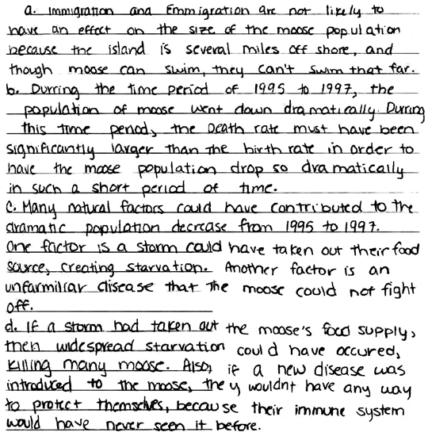
4 points

Slide 31
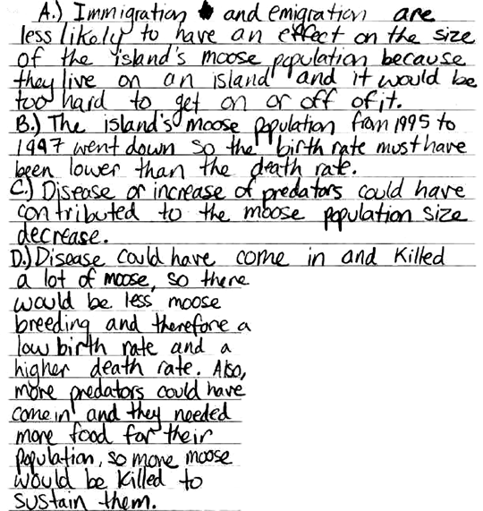
4 points

Slide 32
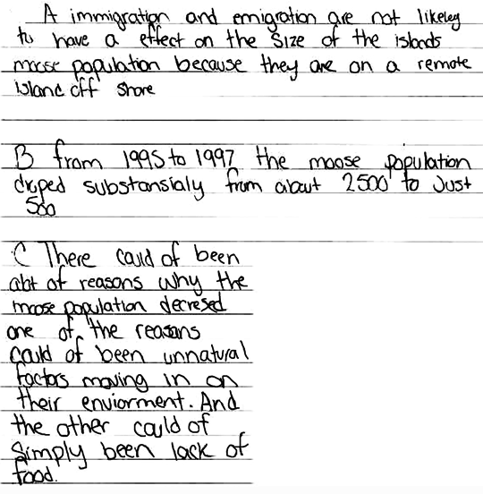
2 Points

Slide 33
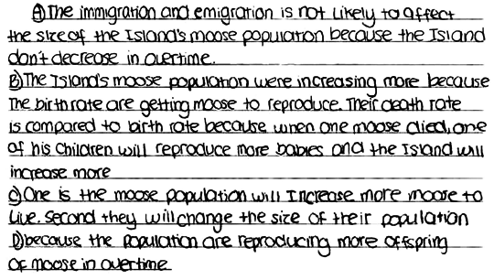
0 Points

