Slide 1
MCAS Review

Slide 2
The chemistry of life

Slide 3
Macromolecules
Many organic compounds in living cells are so large they are known as macromolecules – macro means giant.
Most of these molecules are formed by a process known as polymerization – large compounds are build by joining smaller ones together.

Slide 4
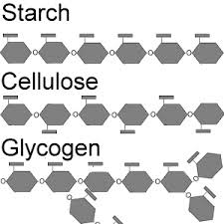
Carbohydrates
Carbohydrates are compounds made up of carbon, hydrogen, and oxygen atoms.
Living things use carbohydrates as their main source of energy. Plants, some animals and other organisms also use carbohydrates for structural purposes.
The cells in our bodies break down glucose to supply energy for cell activities.
Many organisms store extra sugar as complex carbohydrates – starch.

Slide 5
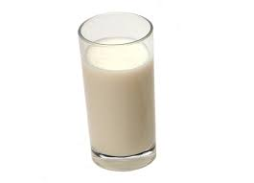
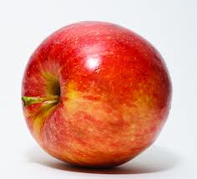
Simple Sugars
Simple sugars are also known as monosaccharides. Glucose is a simple sugar.
Other simple sugars include;
Galactose and lactose– components of milk.
Fructose – found in many fruits
Similar to monosaccarides, disaccharides consist of two simple sugars.
Sucrose – is a combination of glucose and fructose more commonly referred to as table sugar

Slide 6
Complex Carbohydrates
The large macromolecules formed from monosaccharides are known as polysaccharides
Many organisms (including humans) store excess sugars in a polysaccharide known as glycogen.
When your blood sugar drops glycogen is broken down into glucose, which is then released into the blood from your liver.

Slide 7
Lipids
Lipids are a large varied group of biological molecules that are generally not soluble in water.
Lipids are made mostly from carbon and hydrogen atoms and are commonly split into 3 groups;
Fats Oils Waxes
Lipids can be used to store energy and some lipids are important parts of biological membranes and waterproof coverings.
Steroids are lipids that are synthesized by the body. Many steroids act as important chemical messengers.

Slide 8
Glycerol and Fatty Acids
Many lipids are formed when a glycerol molecule combines with compounds called fatty acids.
If each carbon atom in the lipids fatty acid tail is joined to another carbon atom by a single bond the lipid is said to be saturated.
We say a lipid is saturated because the fatty acids contain the maximum possible number of hydrogen atoms.
Saturated fats tend to be solid at room temperature.

Slide 9
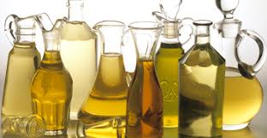
Carbon to Carbon Bonding
If there is at least one C-C double bond in a fatty acid the fatty acid is said to be unsaturated. Lipids with more than one double bond are said to be polyunsaturated.
Unsaturated and polyunsaturated lipids tend to be liquid at room temperature.

Slide 10
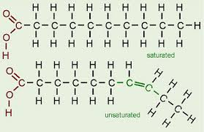
Saturated and Unsaturated Fats

Slide 11
Proteins
Proteins are macromolecules that contain nitrogen as well as carbon, hydrogen, and oxygen.
Proteins are polymers of molecules known as amino acids.
Amino acids are compounds with an amino group (-nh₂) on one end and a carboxyl group (-cooh) on the other end.
In addition each amino acid also contains an r-group that distinguishes one amino acid from another.

Slide 12
Peptide Bonds
Covalent bonds called peptide bonds link amino acids together to form a polypeptide.
A molecule of h₂o is released when the bond is formed.
A protein is a functional molecule built from one or more polypeptides.

Slide 13
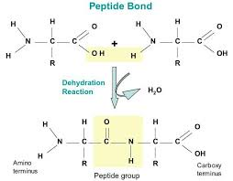
Peptide Bonds Form Through Dehydration Reactions.

Slide 14
Functions of Proteins
Proteins are involved in many different cellular functions:
Control the rate of reactions
Regulate cell processes
Form important cellular structures
Transport substances into and out of cells
Help fight disease

Slide 15
Protein Structure and Function
There are more than 20 different amino acids found in nature.
All are identical in the regions they are joined together by covalent bonds (carboxyl end and the amino group end).
This allows any amino acid to be joined to any other amino acid.
The r-group differentiates amino acids from each other. Some r-groups are acidic, some are basic, some are polar and some are non-polar, and some even contain large ring structures.

Slide 16
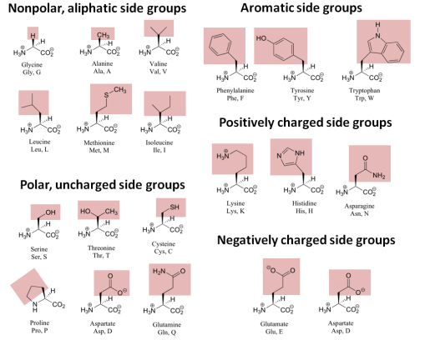
Amino Acids

Slide 17
Levels of Organization
Proteins are split in to various levels of organization, depending on how many polypeptide chains make up a protein.
Primary structure: the sequence of amino acids – this is coded by a cells dna.
Secondary structure: the folding or coiling of the polypeptide chain.
Tertiary structure: the complete 3d arrangement of the polypeptide chain.
Quaternary structure: proteins with more than one polypeptide chain are said to have a 4th level of structure that describes the ways the polypeptide chains are arranged with respect to each other

Slide 18
Nucleic Acids
Nucleic acids are macromolecules that contain hydrogen, oxygen, nitrogen, carbon, and phosphorous.
Nucleic acids are polymers assembled from monomers known as nucleotides.
Nucleotides consist of 3 parts: a 5-carbon sugar, a phosphate group (-po4), and a nitrogenous base.
Some nucleic acids contain the compound adenosine tri-phosphate (atp). This plays an important role in capturing and transferring energy within cells.

Slide 19
Genetics and Heredity
Nucleic acids store and transmit heredity, or genetic information.
There are two types of nucleic acid involved in the transfer and expression of genes – deoxyribose nucleic acid (dna) and ribonucleic acid (rna)
Dna contains the sugar deoxyribose and rna contains the sugar ribose.

Slide 20
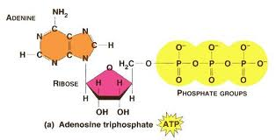
Nucleotide Structure
ATP Structure
DNA Structure
The sequence of complimentary bases hold the key to DNAs ability to transfer genetic information.
ATP stores and releases energy by attaching and snapping off the end phosphate group.

Slide 21
Cell biology

Slide 22
7.1 Life is Cellular
Cell Theory – one of the unifying theories of science
All living things are made of cells
The cell is the basic unit of life – the smallest functional part that is actually considered alive.
New cells are produced from existing cells – cells reproduce by meiosis and mitosis

Slide 23
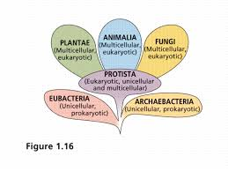
6 Kingdoms
Cell structure
Cell number
Cell reproduction
Modes of nutrition

Slide 24
Prokaryotes and Eukaryotes
All cells are surrounded by a cell membrane (sometimes called a plasma membrane). There are two different types of cell and they vary in many ways.
Eukaryotes
Prokaryotes

Slide 25
The Cell as a Factory

Slide 26
Organelles and structures
Cell membrane
Nucleus
Endoplasmic reticulum
Golgi apparatus
Mitochondria
Chloroplasts
Lysosomes
Vacuoles
Ribosomes
Cytoskeleton
Cilia
Flagella

Slide 27
Cellular Boundaries
All cells are surrounded by a cell membrane
The cell membrane protects the cell and controls what enters or leaves it
The structure of the cell membrane is called the fluid mosaic model
The cell membrane is made from a lipid bilayer – a double layered sheet
It is said to be selectively permeable
The membrane is made from phospholipids but has many proteins embedded in it.
Plant cells and some bacteria also have a cell wall

Slide 28
Cell transport

Slide 29
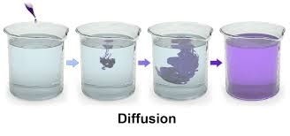
Diffusion
Diffusion is the movement of substances from a high concentration to a low concentration.
Diffusion will result in the eventual equilibrium of concentrations under normal circumstances.

Slide 30
Facilitated Diffusion
Remember the structure of a cell membrane (lipid bilayer with a hydrophilic head and a hydrophobic tail) makes it hard for larger charged particles to cross.
Proteins in the membrane allow many particles to cross much faster than they otherwise would be able to.
This process still relies on diffusion and does not require any additional energy input from the cell.
Osmosis (the diffusion of water) occurs in this way. Water can pass through special proteins called aquaporins.

Slide 31
Active transport
Often cells have to move materials against a concentration gradient. This is known as active transport and requires energy.
A very common example of the protein pump in action is in nerve cells as the Na⁺ and K⁺ pumps actively change the charge within a nerve cell in preparation to pass on a nerve impulse

Slide 32
Exocytosis
Here we can see an animation of a vesicle merging with a cell membrane and particles exiting the cell via exocytosis.

Slide 33
Phagocytosis and Pinocytosis
Phagocytosis is a method of endocytosis in which extensions of the cytoplasm surround a food particle and pack it into a food vacuole. The cell then engulfs it. This also the method that our immune system uses to remove damaged cells.
Another similar process is called pinocytosis where pockets form along the cell membrane, fill with water and pinch of into vacuoles within the cell.

Slide 34
Amoeboid Movement

Slide 35
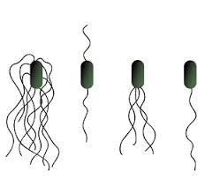
Flagellum
A flagella (plural – flagellum) is a tail like appendage that protrudes from the body of some prokaryotic (and some eukaryotic) cells.
A eukaryotic flagellum is a combination of 9 fused pairs of microtubules and 2 single, central microtubules. This is said to be a 9+2 configuration.
The flagella combine with ATP to propel the cell.

Slide 36
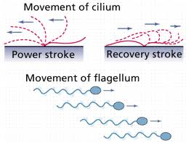
Cilia
Cilium (plural – cilia) are organelles found in Eukaryotic cells.
There are two broad types – motile and non-motile.
Non-motile cilia are primarily used as sensory organs.
Motile cilia are structurally identical to flagella and work by beating back and forth much like the oars in a boat.

Slide 37
Adenosine Triphosphate
Energy in organisms is held in the form of adenosine triphosphate or ATP. ATP consists of adenine (a base) , a 5-carbon sugar called ribose and 3 phosphate groups.
Energy is released from ATP when the covalent bonds joining a phosphate group are snapped off. This leaves us with ADP + P.

Slide 38
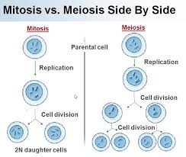
Eukaryotic Reproduction
Asexual – Mitosis
Sexual – Meiosis

Slide 39
Virus vs cell

Slide 40
Photosynthesis

Slide 41
Photosynthesis
In the process of photosynthesis, plants use the energy of sunlight to convert water and carbon dioxide (CO₂) into high energy carbohydrates – sugars and starches.
6CO₂ + 6H₂O >> light >> C₆H₁₂O₆ + 6O₂

Slide 42
Photosynthesis

Slide 43
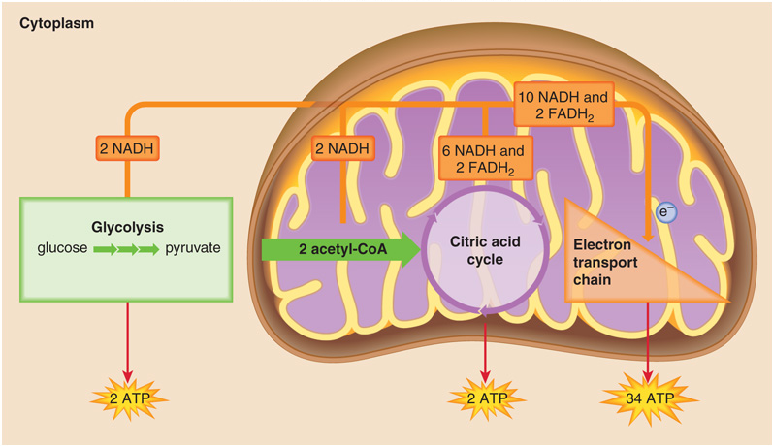
The Stages of Cellular Respiration
H₂O
CO₂

Slide 44
Photosynthesis and Cellular Respiration

Slide 45
Molecular Biology

Slide 46
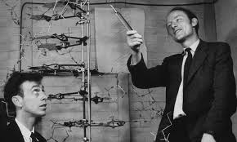
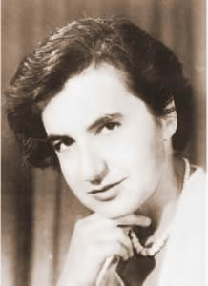
The Double-Helix Model
Watson and Crick
Franklin

Slide 47
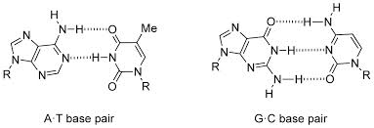
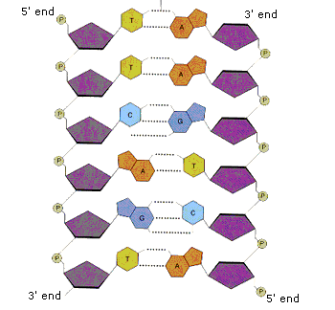
Base Pairing and Hydrogen Bonds
A-T pairs actually have 2 hydrogen bonds and G-C pairs have 3 hydrogen bonds. Remember hydrogen bonds are the same types of bonds that give water its special qualities.
The 5’ and 3’ ends are named after the carbon number on the ribose sugar in each nucleotide.

Slide 48
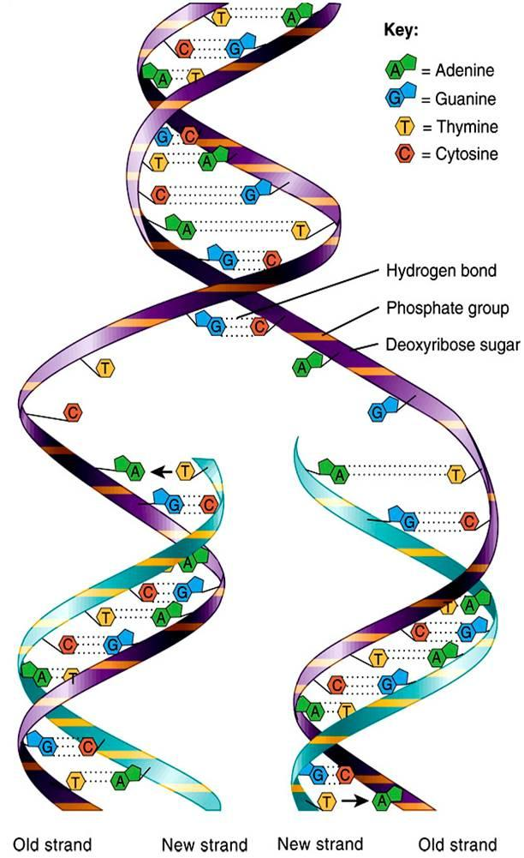
The Replication Process
The DNA molecule is unzipped – this allows two replication forks to form.
As each new strand forms as new bases are added. Adenine is always joined to Thymine and Cytosine is always added to Guanine.
A=T (double bond) and C=G (triple bond).
The result is two DNA strands (made from nucleotide monomers) that are identical to each other and to the original strand.
Each DNA molecule has one of the original strands and one of the new strands. This is known as semi-conservative.

Slide 49
RNA

Slide 50
Central Dogma of molecular biology
Information flow
DNA >>>> RNA >>>> Protein
Transcription
Translation
Protein synthesis

Slide 51
Comparing DNA and RNA
Each nucleotide of DNA is made up of a 5-carbon sugar, a phosphate group, and a nitrogenous base. This is also true for RNA.
However there are 3 important differences between DNA and RNA;
The sugar in RNAis ribose instead of deoxyribose.
RNAis generally single stranded and not double stranded like dna.
RNA contains uracil instead of thymine (A-U instead of A-T).
These chemical differences make it easy for enzymes in the cell to tell the difference between dna and rna.

Slide 52
The Structure of RNA
Ribonucleic Acid (RNA)
Deoxyribonucleic Acid (DNA)

Slide 53
Steps in Translation
Transcription is the process of making an mrna molecule from a DNA template. Transcription is not part of translation but it is critical to it.
Transcription occurs in the nucleus (in eukaryotic cells). Translation is carried out by ribosomes after the mRNA has been transported out of the nucleus in to the cytoplasm.
Translation can often be split into 3 sections; initiation, elongation and termination.

Slide 54
Initiation
Translation begins when a ribosome attaches to a mRNA molecule in the cytoplasm.
mRNA and small sub-unit bind together
Initiator tRNA (UAC) base pairs with start codon (AUG). Start codon tRNA contains methionine (MET) – this may be removed later
Large sub-unit arrives, completing the initiation complex
Energy throughout translation comes from hydrolysis of GTP to GDP+Pi.

Slide 55
Elongation
As each codon passes through the ribosome tRNA brings the appropriate AA into the ribosome
The ribosome attaches these AA to the growing polypeptide chain.
Each tRNA molecule carries just one kind of AA.
tRNA has 3 unpaired bases called anticodons. These are complimentary to the mRNA codon. For example the anticodon for AUG would be UAC.

Slide 56
Termination
The polypeptide continues to grow until the ribosome reaches a “stop” codon (UAG, UAA, and UGA) on the mRNA molecule.
When the stop codon is reaches the ribosome releases both the polypeptide chain and the mRNA molecule, completing the process of translation.

Slide 57
Genetics

Slide 58
Genes and Alleles
An individuals characteristics are determined by factors that are passed from one parental generation to the next.
Today scientists term the factors that are passed from one parent to offspring genes.
The traits that are contained on genes have different versions called alleles.

Slide 59
Segregation and independent assortment
The principle of segregation states that two alleles for each trait separate during meiosis – after fertilization each cell will once again have two alleles for each trait.
The principle of independent assortment states that genes on separate chromosomes sort independently during meiosis.

Slide 60
Punnett Square
Mendel’s F₂ generation = Tt x Tt
Meiosis
T
t
TT
Tt
T
Meiosis
t
Tt
tt

