Slide 1
Introduction to Genetics
Mendelian Genetics Unit

Slide 2
Who needs to know about genetics?
What careers involve the study or knowledge of genetics, and how is this information used?
What are the social, legal, and moral implications of this?

Slide 3
Heredity and Genetics
Most of us are familiar with the concept of inheritance.
People will often write a will dictating where or to whom their money or property will be left.

Slide 4
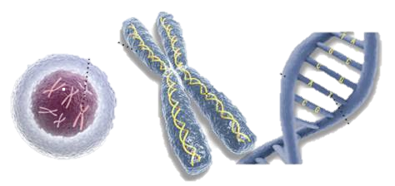
Genetic Inheritance
However we have also inherited our physical characteristics and behaviors from our parents.

Slide 5
Heredity and Genetics
The delivery of characteristics from parents to offspring is known as heredity and the scientific study of heredity is known as genetics.
Notes:
Our genes determine whether we are short or tall blue eyed or brown.

Slide 6
The Work of Gregor Mendel
The modern study of genetics was founded by an Austrian monk named Gregor Mendel in 1822.
After becoming a monk Mendel spend several years at the University of Vienna and then the next 14 years teaching at a monastery high school.

Slide 7
A Theory of Inheritance:
All living things arise from pre-existing things.
Offspring of 2 parents usually resemble the parents
Many traits in the offspring are not exactly like those of either parent.
Heredity – passing on of characteristics from parents to offspring

Slide 8
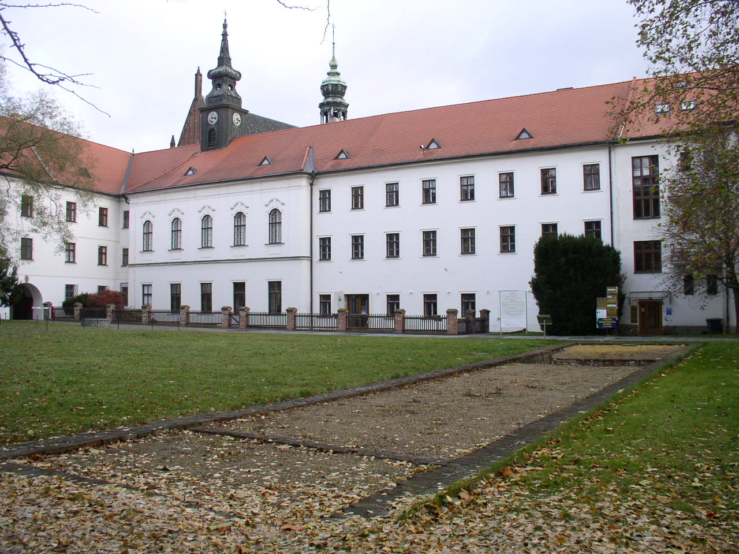
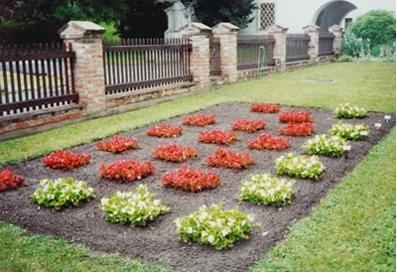
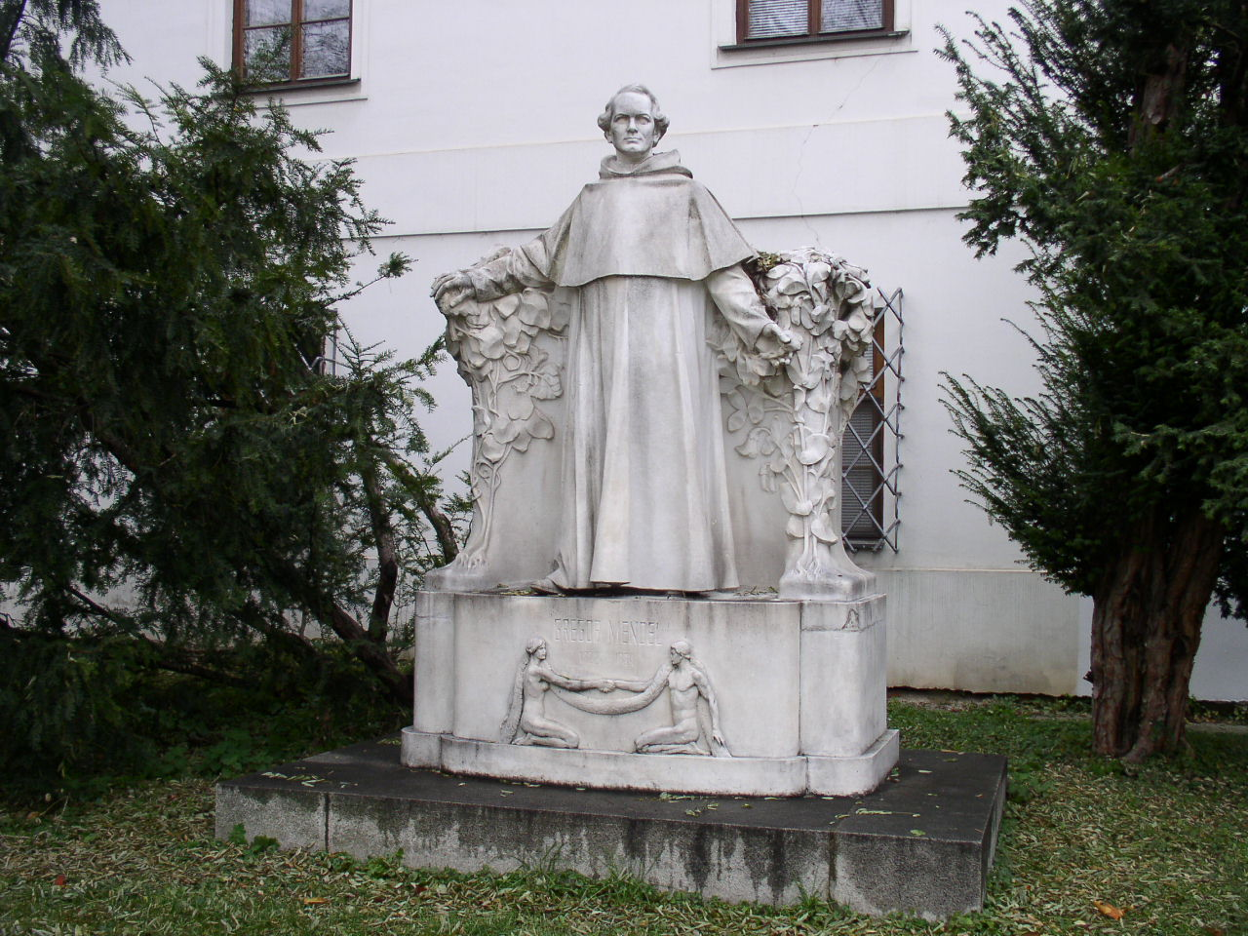
The Work of Gregor Mendel
In addition Mendel was placed in charge of the monastery garden. It was in this simple monastery garden that Mendel changed biology forever

Slide 9
The Work of Gregor Mendel
Mendel carried out a series of experiments on pea plants.
He explored the way genetic information is passed from generation to generation.
Notes:
The experiments carried out by Mendel would have taken 100s of years to perform on larger organisms such as mammals.

Slide 10
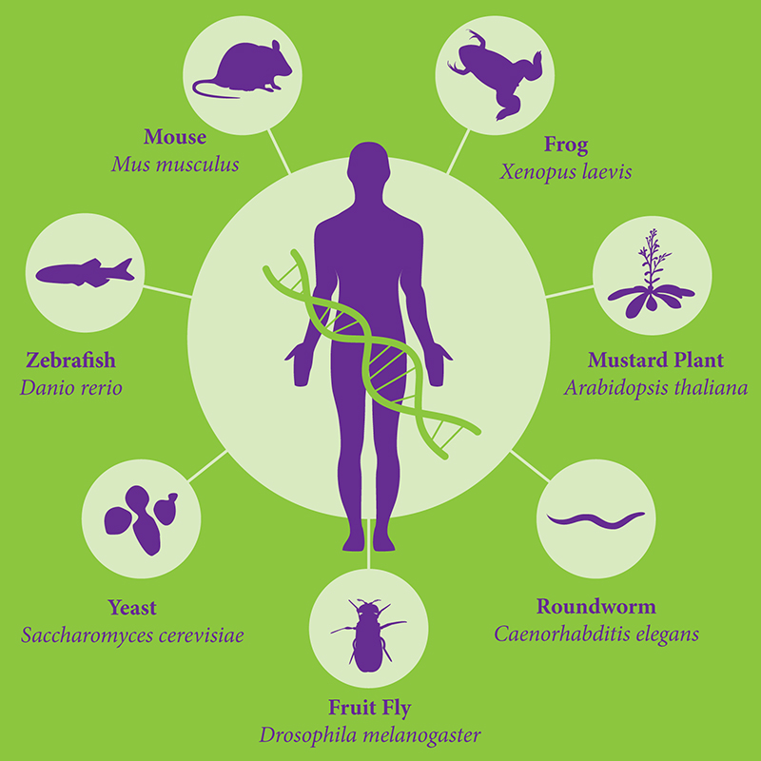
Model Organisms
Pea plants are simple organisms that scientists term a “model system”.
They are a convenient to study and suggest to us ways that other organisms (including humans) may behave.

Slide 11
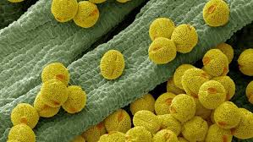
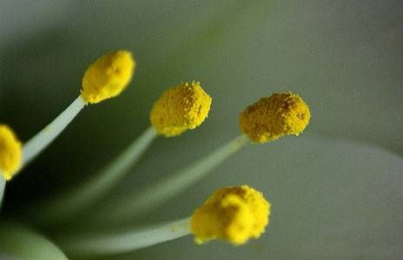
The Role of Fertilization
Mendel knew that the male part of each flower makes pollen which contains the male reproductive cells or gametes (sperm).
The female portion of each plant produces the reproductive cells called eggs.

Slide 12
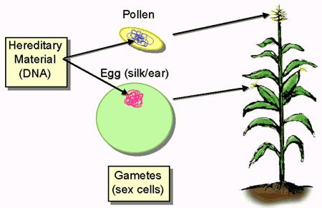
Gametes
A gamete is a germ cell (sex cell) that contains only 1 copy of each chromosome or thhaploid e number.
Males and females each produce gametes for the purposes of reproduction.
Notes:
We will take a closer look at the formation of gametes during the next unit.

Slide 13
Somatic Cells
The normal cells in an organism are referred to as somatic cells.
These cells have the regular amount of genetic information – that is two copies of each chromosome or the diploid number.

Slide 14
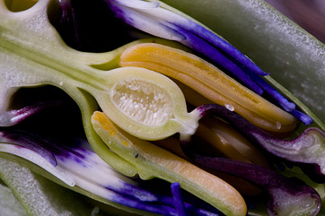
The Role of Fertilization
During sexual reproduction the male and female cells combine in a process known as fertilization, producing a new cell called a zygote.
The cell then develops into an embryo encased within a seed.

Slide 15
The Work of Gregor Mendel
Pea plants are normally self pollinating.
This means that the pea plants joined their own sperm and egg cells (gametes) together to make an offspring.
They had a single parent.
Anther
Stigma
Style
Ovary
Mendel’s garden had stocks of several “true breeding” pea plants.
These plants would produce offspring identical to themselves
Notes:
If organisms can reproduce asexually, why do most reproduce sexually?

Slide 16
Traits
With self fertilization, the traits or characteristics of each successive generation would be the same.
A trait is an observable characteristic such as seed color or plant height that is passed down the parent to offspring.

Slide 17
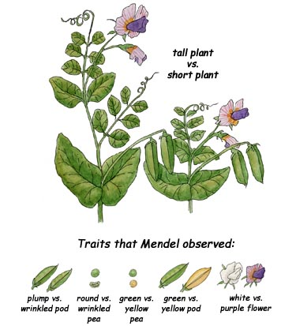
Mendel’s Pea Plants
Mendel’s pea plants varied from had many different observable traits.
For example one stock produced only tall plants another produced only short plants.
One line produced only green seeds another produced only yellow seeds.

Slide 18
Pea Plant Traits

Slide 19
The Work of Gregor Mendel
To find out how these traits were determined Mendel decided to “cross” his stocks of pea plants.
That is he decided to make one plant type reproduce with another plant type.
He did this by cutting the pollen bearing part of the flower off and dusting the female part with pollen from a different plant type.

Slide 20
Cross Pollination

Slide 21
The Work of Gregor Mendel
This process is known as “cross pollination” and produces a plant that has two parents.
Mendel used this process to see if he could produce plants with traits that were different to their parent.

Slide 22
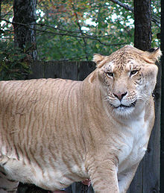
The Work of Gregor Mendel
He crossed plants with each of the 7 different characteristics and studied their offspring.
The resulting offspring from parent with different traits are known as hybrids.

Slide 23
Genes and Alleles
To Mendel’s surprise all of his hybrid plants had the characteristics of only one of the parents.
This led him to make 2 very important conclusions.

Slide 24
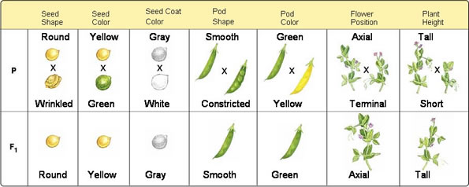
Mendel’s Pea Plant Crosses

Slide 25
Genes and Alleles
Mendel’s first conclusion was:
An individuals traits are determined by factors that are passed from one parental generation to the next.

Slide 26
Genes and Alleles
Scientists term the factors that are passed from one parent to offspring genes.
Each of the traits that Mendel studied was controlled by one gene that occurred in two contrasting varieties. These are known as alleles (uh LEELZ).

Slide 27
Genes are located on chromosomes

Slide 28
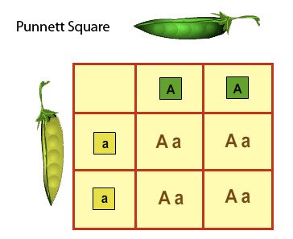
Dominant and Recessive Traits
Mendel’s second conclusion was the principle of dominance.
This principle states that some alleles are dominant and some are recessive.

Slide 29
Dominant and Recessive Traits
An organisms with at least one dominant allele for a particular form of a trait will exhibit that form of the trait.
An organism with a recessive allele for a particular trait will not exhibit that trait if the dominant form is present.

Slide 30
Vocab Check
Complete templates for up to 3 of the following;
Trait, allele, gene, chromosome, dominant, recessive, heredity, and genetics.
Notes:
If students finish earlier they can work on their vocab tiers.
End of lesson #2.

Slide 31
Genetic Crosses
When two organisms reproduce we call this a genetic cross.
We have a few methods of graphically representing this.

Slide 32
Genetic Crosses
When doing genetic crosses we call each original pair of plants the P or parental generation.
Their offspring are called the F₁ or first filial generation (filius and fila are Latin for son and daughter).

Slide 33
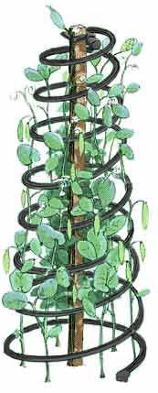
Dominant and Recessive Traits
In Mendel’s experiments the allele for tall plants was dominant to the allele for short plants and the allele for yellow seeds was dominant over the recessive allele for green seeds.
Notes:
Lesson #3

Slide 34
Segregation
Mendel wanted to know if the recessive alleles were still present or had they simply disappeared.
He allowed the F₁ generation to self-pollinate. Effectively crossing the F₁ with itself.
The next generation are known as the F₂ generation (second filial).

Slide 35
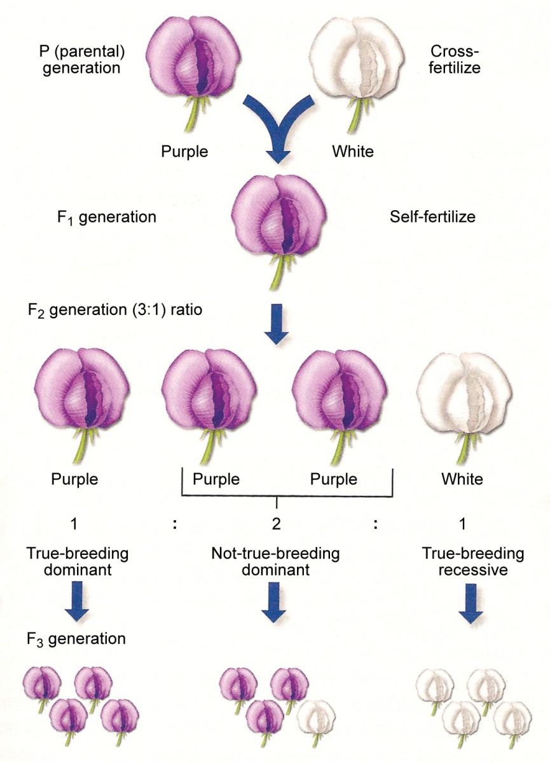
The F₁ Cross
The traits controlled by recessive alleles reappeared in the F₂ generation.
Around ¼ of the F₂ plants showed traits controlled by recessive alleles.
Notes:
Why did the recessive alleles disappear in the F₁ generation only to reappear in the F₂ generation?

Slide 36
Exploring the F₁ Cross
Mendel assumed that the dominant alleles masked the recessive alleles.
Mendel suggested that the dominant and recessive alleles must have segregated during the formation of sex cells.

Slide 37
The Formation of Gametes
The F₁ plants would have inherited the allele for tallness from one parent and the allele for shortness from the other.
The concept of segregation means that each gamete would receive only one of the alleles.

Slide 38
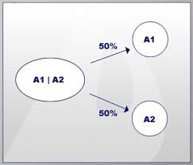
Principle of Segregation
During the formation of gametes the alleles for each gene segregate from each other so that each gamete carries only one type of allele for each gene.
Thus each plant would produce two types of gamete; those with the tall allele and those with the short allele.

Slide 39
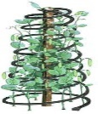
Segregation
TT
tt
T
T
t
t
Tt
Tt
Tt
Tt
T
t
T
t
T
T
t
T
t
T
t
t

Slide 40
Summary of Terms
Inheritance
Trait
Dominant
Recessive

Slide 41
Summary of Terms
Gene
Chromosomes
Allele
Gametes
Fertilization

Slide 42
Summary of Terms
Segregation
P generation
F generation
Notes:
End of lesson #3

