Slide 1
Applying Mendel’s Principles
PPT2

Slide 2
Probability
As we saw in the last section if an organisms has a gene with two alleles there is a 50/50 chance that one of them will be passed on.
Likewise if you were to flip a coin there is a 50% chance it will end up heads and a 50% chance it will end up tails.

Slide 3
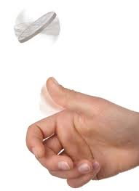
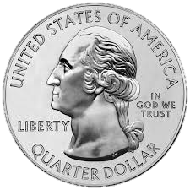
Probability
Every flip of a coin is a unique event with a 50/50 chance of each outcome.
http://www.virtualcointoss.com/

Slide 4
Probability
The probability of flipping 3 heads in a row would be;
½ x ½ x ½ = 1/8
To put it another way there is a 1 in 8 chance of making 3 such flips in a row.
Past outcomes do not effect future results. Flipping a heads in the previous effort does not make you any more or less likely to flip a heads next time.

Slide 5
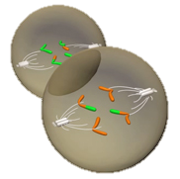
Using Segregation to Predict Outcomes
The ways in which alleles segregate during gamete formation is just as random as a coin flip.
Segregation occurs during gamete formation in a process known as meiosis.

Slide 6
Probability
Therefore we can use the same principles of probability to predict the outcome of genetic crosses.
Lets look at Mendel's F₂ generation again. Remember in the F₂ about ¼ of the offspring were short.
Notes:
We will take a closer look at meiosis in the next unit.

Slide 7
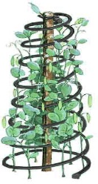
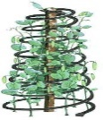
Segregation
P
TT
tt
T
T
t
t
F₁
Tt
Tt
Tt
Tt
T
t
T
t
T
T
t
T
t
T
t
t
F₂

Slide 8
Segregation and Probability
In Mendel’s crosses about ¾ of the plants showed the traits for the dominant allele and about ¼ showed the recessive trait.
As we can see from the previous slide not all the plants displaying the dominant trait have the same combinations of alleles.

Slide 9
Probabilities Predict Averages
If you flip a coin twice you may get one heads and one tails.
You may also get two heads or two tails.
You may have to make many flips before the expected 50/50 ratio is observed.
The same is true for genetics. If an organism only has 4 offspring we may not see Mendel's ratios.
However if an organism has hundreds or thousands of offspring the ratios will usually come very close to matching predictions.

Slide 10
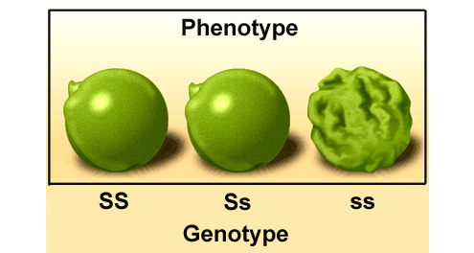
Genotype and Phenotype
Mendel realized that every organism has a genetic make-up as well as a set of observable characteristics.
The observable, physical characteristics are known as the phenotype and the genetic makeup is known as the genotype.
Notes:
The genotype of an organism is inherited whereas the phenotype of an organism is the combination of the environment and the genotype.

Slide 11
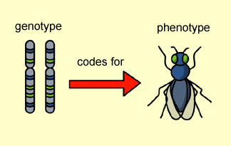
Genotype and Phenotype

Slide 12
Genotype Descriptions
¼ of the plants possessed the TT allele whilst ½ were Tt.
The TT alleles are known has homozygous dominant (homo – the same) and the Tt alleles are heterozygous dominant (hetero – different). The tt alleles are homozygous recessive.

Slide 13
Genotypes
Homozygous dominant: 2 dominant alleles
Heterozygous dominant: 1 dominant allele and 1 recessive
Homozygous recessive: 2 recessive alleles

Slide 14
Using Punnett Squares
Reginald Punnett was a British geneticist who wrote the first genetics text book. He came up with a great tool to shown the outcome of genetic crosses.
Punnett squares are simple diagrams that help us use mathematical probability to predict phenotype and genotype.

Slide 15
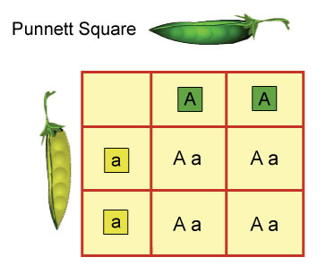
To construct a Punnett square:
Draw a box and enter the possible alleles that a gamete could possess.
Then every possible genotype is filled in within the square as they would appear in the next generation.
Meiosis
Possible next generation
Meiosis

Slide 16
Punnett Square
Mendel’s F₂ generation = Tt x Tt
Meiosis
T
t
TT
Tt
T
Meiosis
t
Tt
tt

Slide 17
What Next?
Previously we looked at patterns of inheritance when only one trait was involved.
Although he didn’t know about genes or DNA Mendel had fortunately only looked at traits governed by a single gene.
Notes:
Lesson #7 Independent assortment

Slide 18
Independent Assortment
Mendel wondered how alleles would segregate when there was more than one gene involved.
He discovered the principle of independent assortment. This states that genes of different traits can segregate independently during the formation of gametes.

Slide 19
Dihybrid Crosses
To explore this principle we will look at a two-factor cross.
These are also known as dihybrid crosses. Crosses involving a single factor are known as monohybrid crosses.
Dihybrid crosses follow the same pattern as monohybrid crosses but involve 2 sets of alleles.

Slide 20
Pea Shape and Color
Mendel looked at true breeding pea plants that produced round peas (RR) and wrinkled peas (rr).
The round peas were yellow (YY) and the wrinkled peas were green (yy).
In the F1 generation all of the offspring had a phenotype of round with yellow peas.

Slide 21
Two-factor Cross: F₁
F₁ generation = RRYY x rryy
Meiosis
ry
ry
ry
ry
RY
RrYy
RrYy
RrYy
RrYy
RY
RrYy
RrYy
RrYy
RrYy
Meiosis
RrYy
RrYy
RrYy
RrYy
RY
RY
RrYy
RrYy
RrYy
RrYy

Slide 22
Two factor Cross
From the data collected in the F₁ generation Mendel could not tell if genes assorted independently as he could only guess at the genotype.
However he now had the hybrid plants needed to produce a F₂ generation that would be more revealing.

Slide 23
Two-Factor Cross: F₂
F₂ generation – RrYy x RrYy
Meiosis
RY
Ry
rY
ry
RY
RRYY
RRYy
RrYY
RrYy
Ry
RRYy
RRyy
RrYy
Rryy
Meiosis
rY
RrYY
RrYy
rrYY
rrYy
ry
RrYy
Rryy
rrYy
rryy

Slide 24
F₂ Results
The F₂ generation resulted in an approximate ratio of 9:3:3:1 which we predicted in our F₂ Punnett square.
In other words if there had been exactly 16 offspring we might have expected;
9 of them to me round with yellow peas (RRYY, RrYY, or RrYy)
3 of them to be wrinkled with yellow peas (rrYY or rrYy)
3 of them to be round with green peas (RRyy or Rryy)
1 to be wrinkled with green peas (rryy).

Slide 25
Summary of Mendel’s principles
Mendel’s principles of heredity form the basis of modern genetics.
The inheritance of biological characteristics is determined by individual units called gene, passed from parents to offspring.
Where two or more forms (alleles) of a gene for a single trait exist some alleles may be dominant and others may be recessive.
In most sexually reproductive organisms, each adult has two copies of each gene – one from each parent.

Slide 26
Summary of Mendel’s principles
Each gene segregates from its copy when gametes are formed so only one gene will be passed on to the next generation from each parent.
Alleles for different genes usually segregate from each other independently.

Slide 27
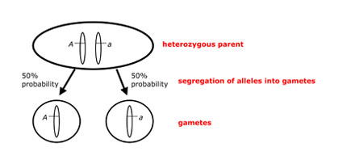
Principle of Segregation
The principle of segregation states that two alleles for each trait separate during meiosis – after fertilization each cell will once again have two alleles for each trait.

Slide 28
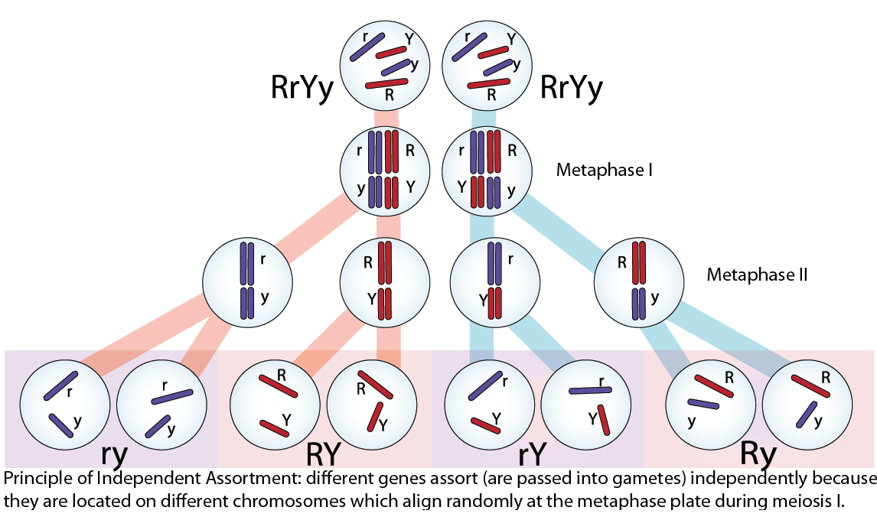
Principle of Independent Assortment
The principle of independent assortment states that genes on separate chromosomes sort independently during meiosis.

Slide 29
Pedigrees
In organisms such as fruit flies and peas, scientists perform crosses to study genetic relationships.
In the case of some organisms such as humans scientists will use a pedigree – a diagram that traces the inheritance of a particular trait through several generations

Slide 30
Example Pedigree

Slide 31
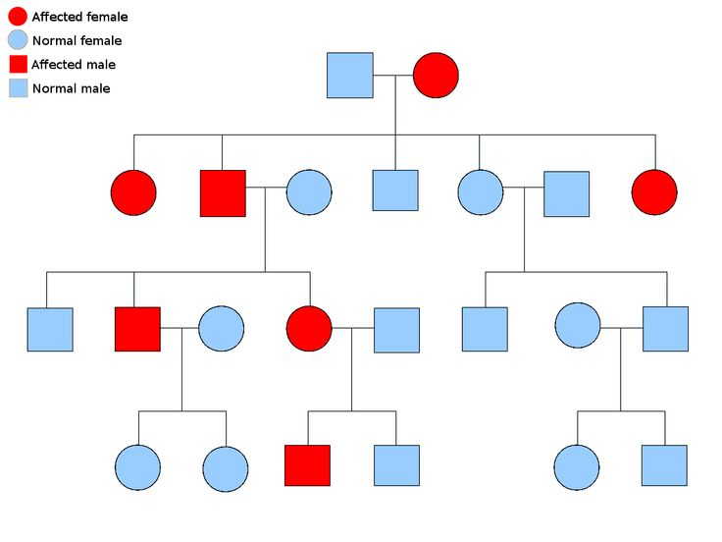

Slide 32
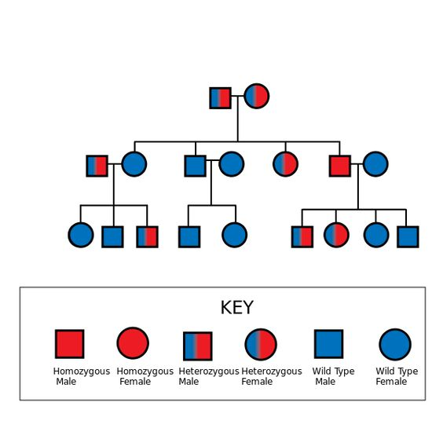

Slide 33
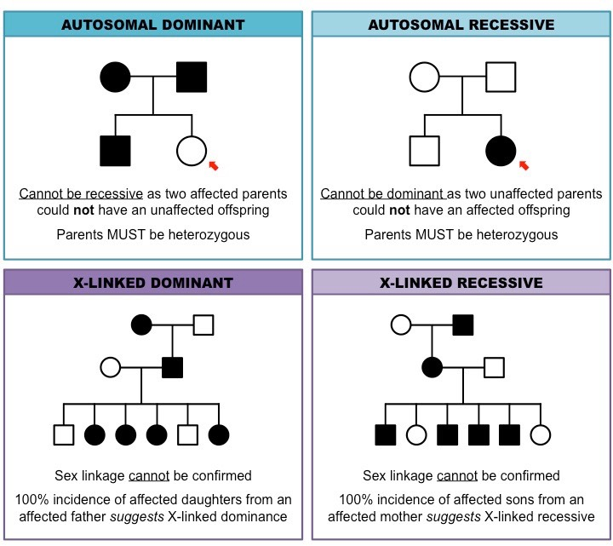

Slide 34
Other Patterns of Inheritance
PPT 3
Notes:
This information is unlikely to be covered in class but is included for students who are interested in learning more about genetics.

Slide 35
Beyond Dominant and Recessive Alleles
Despite the importance of Mendel’s work there are exceptions to most of his principles.
Not all genes show simple patterns of inheritance and many genes have more than one allele.
Mendel’s principles alone cannot predict traits that are controlled by multiple alleles or multiple genes.

Slide 36
Incomplete Dominance
Some alleles are neither dominant nor recessive.
For example four o’clock plants (Mirabilis) display what is termed incomplete dominance.

Slide 37
Incomplete Dominance
If a white-flowered plant (WW) is crossed with a red-flowered plant (RR) the resulting F₁ generation will be pink-flowered (RW).
The resulting offspring have heterozygous phenotypes that lie somewhere in between the two homozygous phenotypes.

Slide 38
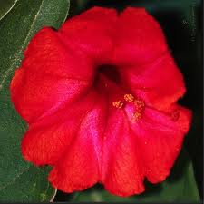
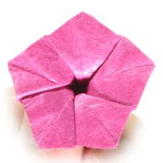
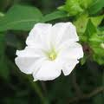
Incomplete Dominance
R
R
W
W

Slide 39
Codominance
Codominance is similar to incomplete dominance in that the phenotypes from both alleles are clearly expressed.
For example in certain varieties of chicken the allele for black feathers and the allele for white are both clearly displayed.

Slide 40
Codominance
Unlike in incomplete dominance there is no blending of colors. The chickens appear as speckled (or erminette).
This is known as codominance.

Slide 41
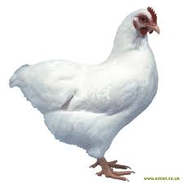
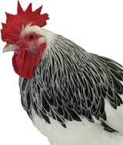
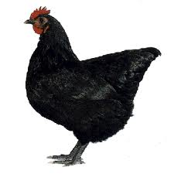
Codominance
W
W
B
B

Slide 42
Multiple Alleles
Mendel's principles look at genes with two alleles.
These however are the exception rather than the rule.
Many genes have multiple alleles, although each organisms will still only have two copies of each one.
The alleles still display simple patterns of dominance. Examples include rabbit fur color or human blood types.

Slide 43
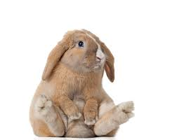
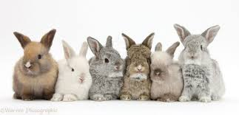
Fur Color
Rabbit fur color is determined by a single gene with 4 different alleles. The simple hierarchy of dominance can produce 4 different fur colors.

Slide 44
Human Blood Type
Human blood cells carry antigens (molecules that can trigger an immune response) on their surface.
Type A carries the A antigen, type B has the B antigen, AB has both and O carries neither.
The antigen has 3 alleles A, B, and O.

Slide 45
Human Blood Cells
For blood transfusions to be successful the new blood must not introduce a new antigen into the body (or the immune system will attack it).
So someone with type A blood could receive type O but not the other way round.
Another gene controls a second type of antigen known as Rh factor. Rh+ individuals have this gene and Rh- individuals don’t.

Slide 46
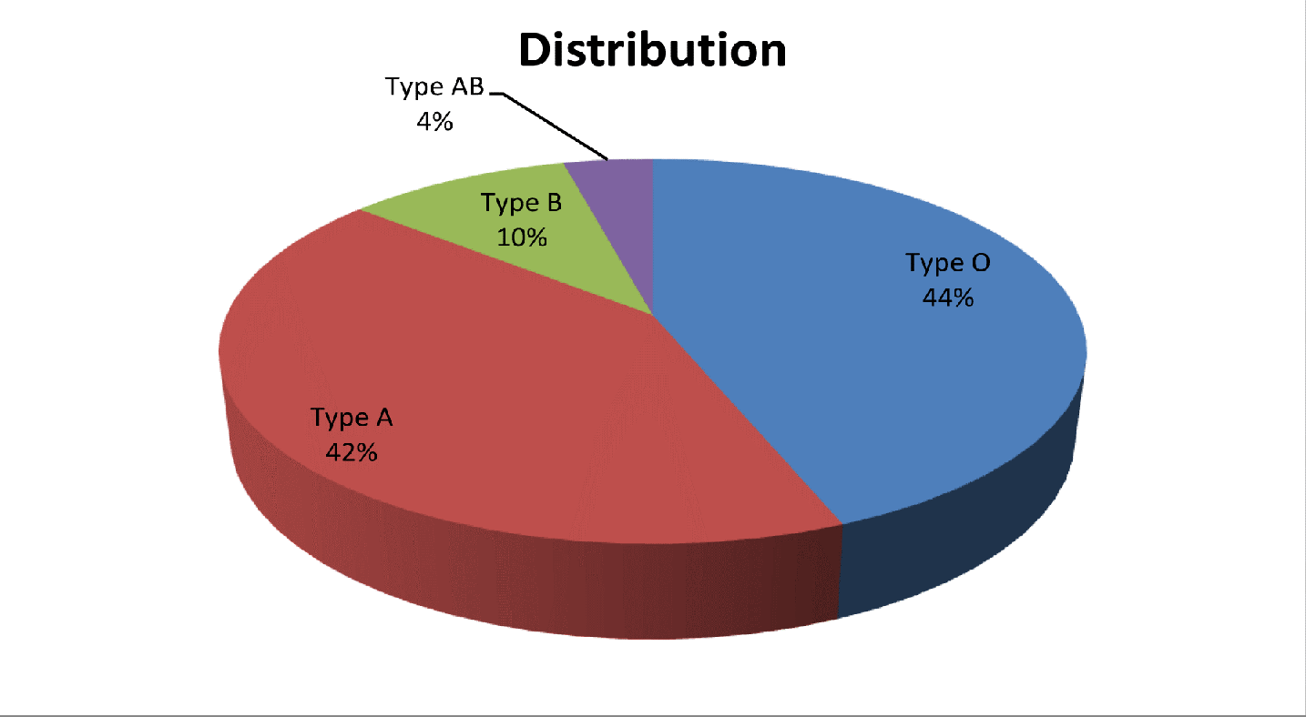
Human Blood Types

Slide 47
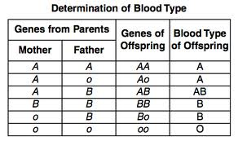
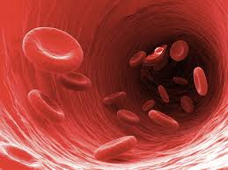
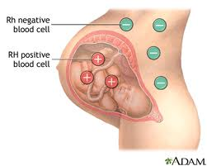
Human Blood Types and Heredity
Rh+ is dominant over Rh-. Doctors always play close attention to Rh factors when giving blood transfusions but in truth it is more of an issue when a mother and fetus share an incompatible blood type.

Slide 48
Polygenic Traits
Many traits are controlled by the interaction on two or more genes.
Any trait controlled by two or more genes is said to be polygenic (polygenic means many genes).
The wide range of skin colors in humans is a result of polygenic gene interactions. Eye color and finger print pattern are two more examples.

Slide 49
Epistasis
Coat color in Labrador retrievers can vary in color from yellow to black.
This variety is the result on one allele hiding another – this is known as epistasis (Greek for standing upon).
Black coat color is dominant to brown. If we designate B as the dominant allele and b as the recessive, a lab would need to be bb to have a chocolate coat.

Slide 50
Epistasis
However there is more to the story. A second gene determines whether or not pigment will be deposited into the coat at all.
The dominant allele E determines results in deposition of pigment. An individual homozygous recessive for the second locus (ee) will have a yellow coat (no pigment) regardless of the gene for color.
bbEE or bbEe will result in a chocolate brown colored dog. Genotype BBee, Bbee, or bbee will produce yellow coats.
BBEE, BbEE, BBEe, or, BbEe will result in a black coat.

Slide 51
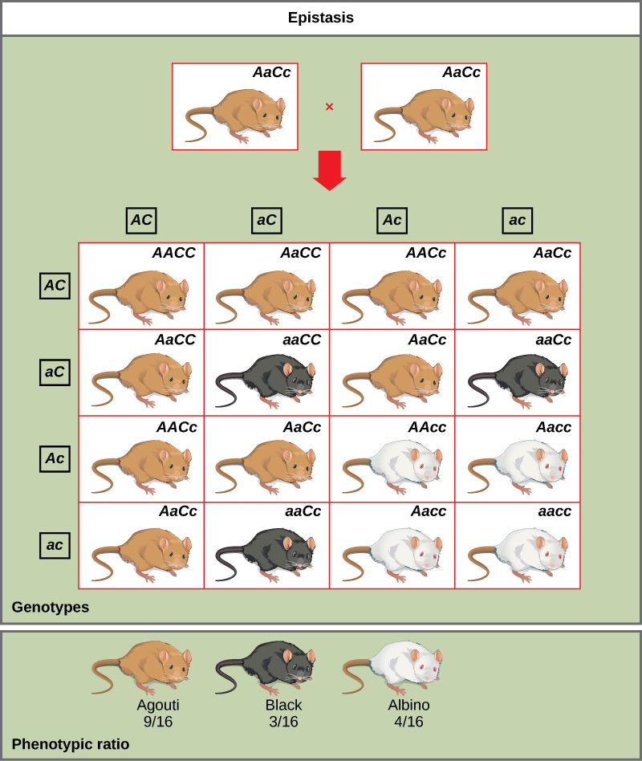
Epistasis

Slide 52
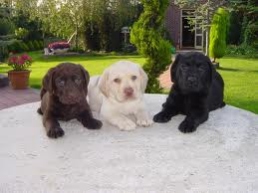
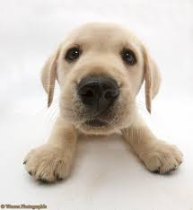
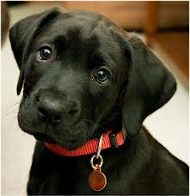
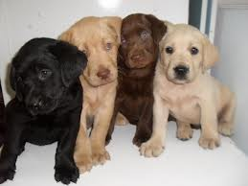
Lab Coat Color

Slide 53
Genes and the Environment
The environment also plays a role in how genes are expressed.
Environmental conditions can affect gene expression and influence how genes are expressed.
For example temperature will often dictate how much of a certain pigment organisms will produce. The can dramatically affect the phenotype observed.

Slide 54
Western White Butterfly
The Western White Butterfly has a distinctly different appearance based on the time of year it is born.
Butterflies born in the spring time have significantly higher levels of pigment than those born in the summer.
The reason for this is that the wings need to be a certain temperature in order for the organisms to be able to fly. Therefore butterflies born during the colder spring months need more pigment.

Slide 55
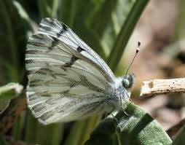
Spring v Summer
Spring
Summer

Slide 56
Sex Determination
We have 22 pairs of autosomes and 1 pair of sex chromosomes.
These chromosomes determine a persons gender. Males have both an X and Y chromosome and females have two X chromosomes.
Therefore it is essentially the male who determines gender in humans.

Slide 57
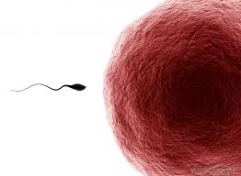
Gender Determination
X
Y
XX
XY
X
X
XX
XY

Slide 58
Sex-Linked Traits
Traits controlled by genes located on the X chromosome are termed sex-linked traits or X-linked traits.
Because males have only one X chromosome they are affected by recessive X-linked genes more often than females.
Females are less likely to express a recessive X-linked trait as the other X chromosome may mask the effect of the trait.

Slide 59
Sex-linked Inheritance
X^{A}
Y
X^{A}X^{A}
X^{A}Y
X^{A}
Xª
X^{A}Xª
XªY

Slide 60
Red-green Color Blindness
Red-green color blindness is a recessive sex-linked trait.
About 8% of males in the US have red-green color blindness.
Red-green color blindness is very rare in females.

Slide 61
Red-green Color Blindness
X^{B}
Y
X^{B}
X^{B}X^{B}
X^{B}Y
X^{b}
X^{B}X^{b}
X^{b}Y
X^{B}= normal
X^{b}= red-green color blind
Y= Y chromosome

Slide 62
Male-pattern Baldness
Baldness may appear to be a sex-linked trait but it is not.
The reason why more males are bald is that the gene for baldness is dominant in males but recessive in females.
A male would be bald if he were homozygous dominant or heterozygous dominant but a female would only be bald if she were homozygous recessive.

Slide 63
Recessive Genetic Disorders
Many genetic disorders will be the result of having two recessive genes.
People who have on recessive gene for a genetic disorder are called carriers.
Sometimes there are evolutionary advantages to being a carrier but not double recessive. For example people who are heterozygous dominant for the gene which causes sickle cell anemia.

Slide 64
Recessive Disorders
Disorder | Occurrence in the US | Cause | Effect | Cure or treatment
Cystic fibrosis | 1 in 3500 | The gene that codes for a membrane protein is defective | Excessive mucus production and digestive and respiratory failure | No cure Daily cleaning of mucus from lungs, mucus thinning drugs, pancreatic enzyme supplements
Albinism | 1 in 17000 | Genes do not produce normal amounts of melanin | No color in skin, eyes and hair. Skin susceptible to UV damage, vision problems | No cure. Protect skin from Sun and environmental factors, visual rehabilitation
Tay-Sachs disease | 1 in 2500 | Absence of necessary enzyme to break down fatty substances | Buildup of fatty deposits in the brain, mental disability | No cure or treatment. Death by age 5

Slide 65
Dominant Disorders
Some genetic disorders are caused by the dominant gene.
In these disorders people who don t have the gene are homozygous recessive.
These types of disorder can cause things like Huntington’s disease – a nervous system disorder resulting in loss of brain function.

Slide 66
Dominant Disorders
Disorder | Occurrence in US | Cause | Effect | Cure/Treatment
Huntington’s disease | 1 in 10000 | A gene affecting neurological functions is defective | Decline of mental and neurological functions. Ability to move deteriorates | No cure or treatment
Achondroplasia | 1 in 25000 | A gene that affects bone growth is abnormal | Short arms and legs, large head | No cure or treatment

