Slide 1
Other Patterns of Inheritance
Chapter 11.3

Slide 2
Beyond Dominant and Recessive Alleles
Despite the importance of Mendel’s work there are exceptions to most of his principles.
Not all genes show simple patterns of inheritance and many genes have more than one allele.
Mendel’s principles alone cannot predict traits that are controlled by multiple alleles or multiple genes.

Slide 3
Incomplete Dominance
Some alleles are neither dominant nor recessive.
For example four o’clock plants (Mirabilis) display what is termed incomplete dominance.
If a white-flowered plant (WW) is crossed with a red-flowered plant (RR) the resulting F₁ generation will be pink-flowered (RW).
The resulting offspring have heterozygous phenotypes that lie somewhere in between the two homozygous phenotypes.

Slide 4
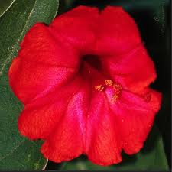
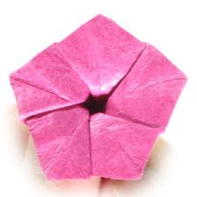
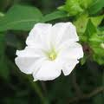
Incomplete Dominance
R
R
W
W

Slide 5
Codominance
Codominance is similar to incomplete dominance in that the phenotypes from both alleles are clearly expressed.
For example in certain varieties of chicken the allele for black feathers and the allele for white are both clearly displayed.
Unlike in incomplete dominance there is no blending of colors. The chickens appear as speckled (or erminette).
This is known as codominance.

Slide 6
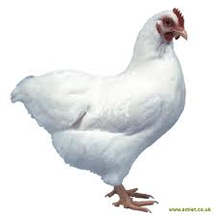
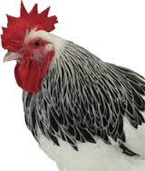
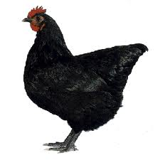
Codominance
W
W
B
B

Slide 7
Multiple Alleles
Mendel's principles look at genes with two alleles.
These however are the exception rather than the rule.
Many genes have multiple alleles, although each organisms will still only have two copies of each one.
The alleles still display simple patterns of dominance. Examples include rabbit fur color or human blood types.

Slide 8
Rabbit Fur Color
Rabbit fur color is determined by a single gene with 4 different alleles. The simple hierarchy of dominance can produce 4 different fur colors.

Slide 9
Human Blood Type
Human blood cells carry antigens (molecules that can trigger an immune response) on their surface.
Type A carries the A antigen, type B has the B antigen, AB has both and O carries neither.
The antigen has 3 alleles A, B, and O.

Slide 10
Human Blood Cells
For blood transfusions to be successful the new blood must not introduce a new antigen into the body (or the immune system will attack it).
So someone with type A blood could receive type O but not the other way round.
Another gene controls a second type of antigen known as Rh factor. Rh+ individuals have this gene and Rh- individuals don’t.

Slide 11
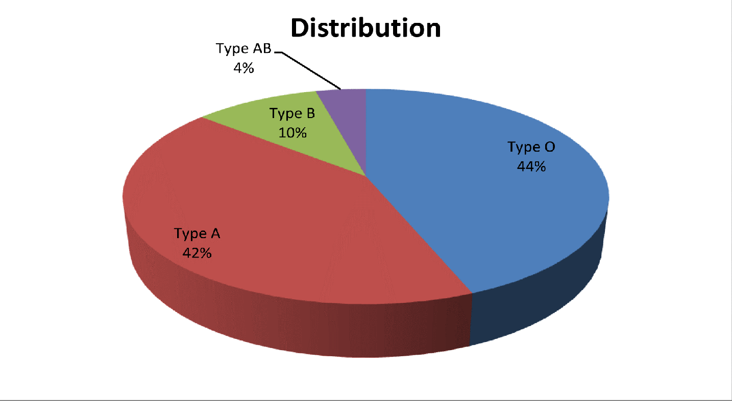
Human Blood Types

Slide 12
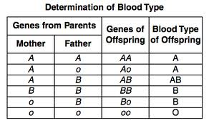
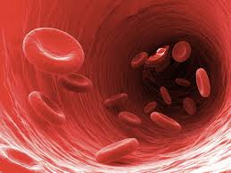
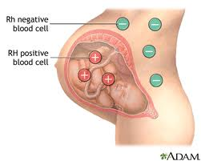
Human Blood Types and Heredity
Rh+ is dominant over Rh-. Doctors always play close attention to Rh factors when giving blood transfusions but in truth it is more of an issue when a mother and fetus share an incompatible blood type.

Slide 13
Polygenic Traits
Many traits are controlled by the interaction on two or more genes.
Any trait controlled by two or more genes is said to be polygenic (polygenic means many genes).
The wide range of skin colors in humans is a result of polygenic gene interactions. Eye color and finger print pattern are two more examples.

Slide 14
Epistasis
Coat color in Labrador retrievers can vary in color from yellow to black.
This variety is the result on one allele hiding another – this is known as epistasis (Greek for standing upon).
Black coat color is dominant to brown. If we designate B as the dominant allele and b as the recessive, a lab would need to be bb to have a chocolate coat.

Slide 15
Epistasis
However there is more to the story. A second gene determines whether or not pigment will be deposited into the coat at all.
The dominant allele E determines results in deposition of pigment. An individual homozygous recessive for the second locus (ee) will have a yellow coat (no pigment) regardless of the gene for color.
bbEE or bbEe will result in a chocolate brown colored dog. Genotype BBee, Bbee, or bbee will produce yellow coats.
BBEE, BbEE, BBEe, or, BbEe will result in a black coat.

Slide 16
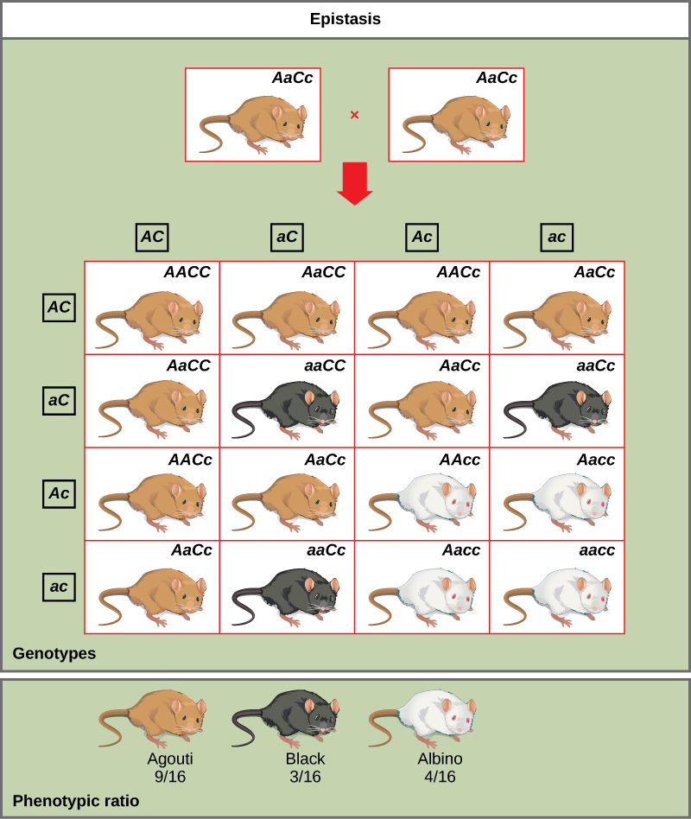
Epistasis

Slide 17
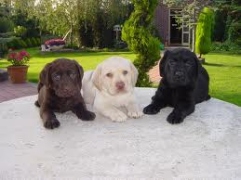
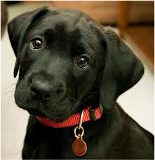
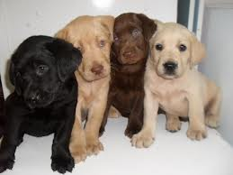
Lab Coat Color

Slide 18
Genes and the Environment
The environment also plays a role in how genes are expressed.
Environmental conditions can affect gene expression and influence how genes are expressed.
For example temperature will often dictate how much of a certain pigment organisms will produce. The can dramatically affect the phenotype observed.

Slide 19
Western White Butterfly
The Western White Butterfly has a distinctly different appearance based on the time of year it is born.
Butterflies born in the spring time have significantly higher levels of pigment than those born in the summer.
The reason for this is that the wings need to be a certain temperature in order for the organisms to be able to fly. Therefore butterflies born during the colder spring months need more pigment.

Slide 20
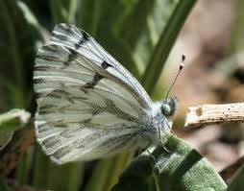
Spring v Summer
Spring
Summer

Slide 21
Sex Determination
We have 22 pairs of autosomes and 1 pair of sex chromosomes.
These chromosomes determine a persons gender. Males have both an X and Y chromosome and females have two X chromosomes.
Therefore it is essentially the male who determines gender in humans.

Slide 22
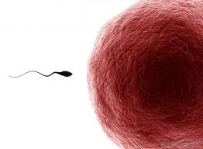
Gender Determination
X
Y
XX
XY
X
X
XX
XY

Slide 23
Sex-Linked Traits
Traits controlled by genes located on the X chromosome are termed sex-linked traits or X-linked traits.
Because males have only one X chromosome they are affected by recessive X-linked genes more often than females.
Females are less likely to express a recessive X-linked trait as the other X chromosome may mask the effect of the trait.

Slide 24
Sex-linked Inheritance
X^{A}
Y
X^{A}X^{A}
X^{A}Y
X^{A}
Xª
X^{A}Xª
XªY

Slide 25
Red-green Color Blindness
Red-green color blindness is a recessive sex-linked trait.
About 8% of males in the US have red-green color blindness.
Red-green color blindness is very rare in females.

Slide 26
Red-green Color Blindness
X^{B}= normal
X^{b}= red-green color blind
Y= Y chromosome
X^{B}
Y
X^{B}
X^{B}X^{B}
X^{B}Y
X^{b}
X^{B}X^{b}
X^{b}Y

Slide 27
Male-pattern Baldness
Baldness may appear to be a sex-linked trait but it is not.
The reason why more males are bald is that the gene for baldness is dominant in males but recessive in females.
A male would be bald if he were homozygous dominant or heterozygous dominant but a female would only be bald if she were homozygous recessive.

Slide 28
Recessive Genetic Disorders
Many genetic disorders will be the result of having two recessive genes.
People who have on recessive gene for a genetic disorder are called carriers.
Sometimes there are evolutionary advantages to being a carrier but not double recessive. For example people who are heterozygous dominant for the gene which causes sickle cell anemia.

Slide 29
Recessive Disorders
Disorder | Occurrence in the US | Cause | Effect | Cure or treatment
Cystic fibrosis | 1 in 3500 | The gene that codes for a membrane protein is defective | Excessive mucus production and digestive and respiratory failure | No cure Daily cleaning of mucus from lungs, mucus thinning drugs, pancreatic enzyme supplements
Albinism | 1 in 17000 | Genes do not produce normal amounts of melanin | No color in skin, eyes and hair. Skin susceptible to UV damage, vision problems | No cure. Protect skin from Sun and environmental factors, visual rehabilitation
Tay-Sachs disease | 1 in 2500 | Absence of necessary enzyme to break down fatty substances | Buildup of fatty deposits in the brain, mental disability | No cure or treatment. Death by age 5

Slide 30
Dominant Disorders
Some genetic disorders are caused by the dominant gene.
In these disorders people who don t have the gene are homozygous recessive.
These types of disorder can cause things like Huntington’s disease – a nervous system disorder resulting in loss of brain function.

Slide 31
Dominant Disorders
Disorder | Occurrence in US | Cause | Effect | Cure/Treatment
Huntington’s disease | 1 in 10000 | A gene affecting neurological functions is defective | Decline of mental and neurological functions. Ability to move deteriorates | No cure or treatment
Achondroplasia | 1 in 25000 | A gene that affects bone growth is abnormal | Short arms and legs, large head | No cure or treatment

Slide 32
Pedigrees
In organisms such as fruit flies and peas, scientists perform crosses to study genetic relationships.
In the case of some organisms such as humans scientists will use a pedigree – a diagram that traces the inheritance of a particular trait through several generations

Slide 33
Example Pedigree

