Slide 1
Photosynthesis: An Overview
Chapter 8.2

Slide 2
Photosynthesis
The word photosynthesis comes from the Greek word photo meaning light and the synthesis meaning put together.
Therefore photosynthesis means “using light to put together”.
In this process plants convert the energy of sunlight into chemical energy stored in the bonds of carbohydrates.

Slide 3
Photosynthesis
In the process of photosynthesis, plants use the energy of sunlight to convert water and carbon dioxide (CO₂) into high energy carbohydrates – sugars and starches.
6CO₂ + 6H₂O >> light >> C₆H₁₂O₆ + 6O₂

Slide 4
Investigating Photosynthesis
Research into photosynthesis began centuries ago when scientists asked a simple question:
Where does a trees increase in mass come from?
Is it from soil? Water? Air?

Slide 5
Van Helmont’s Experiment
In the 1600s physician Jan van Helmont devised an experiment to find out if plants grew by taking material from soil.
He weighed the soil that he placed a seedling into and watered it daily. By the end of a 5 year period he found that the seedling (now a tree) had increased in mass by 75Kgs.
The mass of the soil however was almost unchanged.
He concluded that most of the increase in mass must have come from water.

Slide 6
Van Helmond's Conclusions
Van Helmonds experiment accounted for the “hydrate” portion of carbohydrates.
What was still unclear was where the carbon element came from.
Carbo
hydrate

Slide 7
Joseph Prestley
More than 100 years after van Helmond’s experiment Englishman Joseph Prestley was able to shed more light on photosynthesis.
Prestley discovered that plants gave off oxygen. He did this with a couple of simple experiments involving candles and plants in an airtight container,

Slide 8
Jan Ingenhouse
Later, Dutch scientist Jan Ingenhousz showed that plants only released oxygen in the presence of light.
This led to many other scientists discovering that in the presence of light plants can transform carbon in the air into carbohydrates whilst at the same time they are also releasing oxygen.

Slide 9
The Photosynthesis Equation
Photosynthesis usually produces a 6-carbon sugar as the final product.
6CO₂ + 6H₂O >> light >> C₆H₁₂O₆ + 6O₂
Carbon Dioxide + Water >> light >> Sugars + Oxygen
Photosynthesis uses the energy of sunlight to convert water and carbon dioxide into high energy sugars and oxygen.

Slide 10
Photosynthesis

Slide 11
Light and Pigments
In order to use the low energy raw materials to make high energy sugars plants must have a way of harnessing light energy.
This is achieved through pigments called chlorophyll – a molecule contained in the chloroplasts.

Slide 12
Energy From The Sun
Energy from the Sun travels to the Earth in the form of sunlight which your eyes perceive as “white” light.
“White” light is actually a mixture of many different wavelengths of light some of which are visible to your eye – the visible spectrum.

Slide 13
Visible Light

Slide 14
Pigments
Energy from the Sun comes in the form of photons. These photons excite electrons within the leaf of a plant.
Plants gather the suns energy with pigments called chlorophyll – chlorophyll a and chlorophyll b.
Chlorophyll absorbs light well in the blue-violet and red regions of the visible spectrum.
However chlorophyll does not absorb light well in the green spectrum. This is why leaves appear green to our eyes.
Plants also contain other pigments such as carotene that absorb light well in red and orange regions.

Slide 15
Chlorophyll and Carotenoids

Slide 16
Photosynthesis
Photosynthesis is the process of harnessing the energy from the sun and combining this energy with other compounds to make sugars.
6CO₂ + 6H₂O >> light >> C₆H₁₂O₆ + 6O₂

Slide 17
Photosynthesis Summary

Slide 18
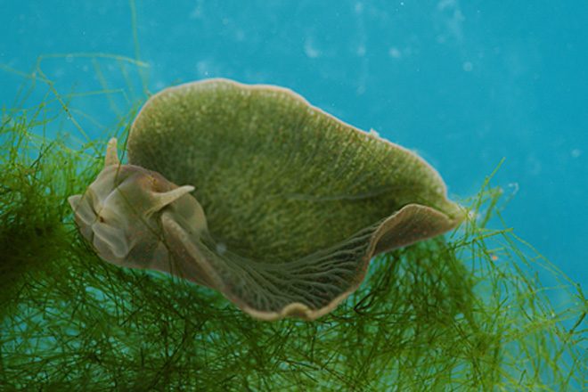
Chloroplasts
Photosynthesis occurs in the chloroplasts of cells. Chloroplasts are almost exclusively found in plant cells.
The Green Sea Slug is one of only a very few exceptions – it has some chloroplasts and can produce its own pigment.

Slide 19
Chloroplasts

Slide 20
Thylakoids
The energy from the Sun is trapped by pigments held the thylakoids.
The pigments can be found in photosystems (photosystem II and Photosystem I) held in the thylakoid membrane.
The thylakoids are stacked into piles called grana.

Slide 21
The Stroma and The Calvin Cycle
The energy made during the light dependent phase of photosynthesis is used to convert CO₂ and existing molecules within the chloroplast into simple sugars.
These reactions take place in the stroma of the chloroplast and are known as the Calvin Cycle or the light independent reactions.

Slide 22
Photosynthesis

Slide 23
Photosynthesis and Cellular Respiration
Photosynthesis and cellular respiration are closely related chains of reactions.
We can see that both these reactions are basically the reverse of each other.
Photosynthesis involves using ATP to build sugar.
Cellular respiration involves breaking down sugar to produce ATP.

Slide 24
Photosynthesis and Cellular Respiration

Slide 25
Websites
http://www.youtube.com/watch?v=uYWuqxo91VA
http://www.youtube.com/watch?v=s8gIxYUR0Ao
http://www.youtube.com/watch?v=mYbMPwmwx88
http://www.youtube.com/watch?v=pdgkuT12e14
http://www.youtube.com/watch?v=g78utcLQrJ4
http://www.youtube.com/watch?v=ZnY9_wMZZWI
http://www.youtube.com/watch?v=2xNwZCk2CHY
http://www.bbc.co.uk/learningzone/clips/plant-photosynthesis/6126.html

Slide 26
Photosynthesis Review

Slide 27
Photosynthesis
Through photosynthesis some organisms can make their own food.
These organisms are known as autotrophs
Organisms who have to get their food by eating other organisms are known as heterotrophs.

Slide 28
Energy
Energy in cells is released when chemical bonds are broken
Energy in cells is stored in the form of glucose which can be broken down to provide energy to phosphorylate ADP and transform it into ATP.
ATP is the cells energy storage molecule.

Slide 29
Photosynthesis
Glucose and O₂

Slide 30
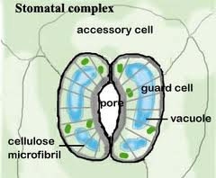
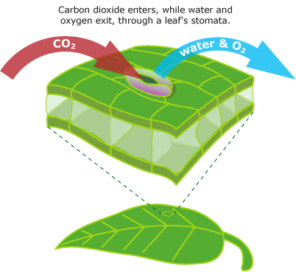
Stomata
Leaves have pores on them called stomata that can open and close in response to environmental conditions.
When closed these stop H₂O from being lost but also stop photosynthesis from occurring

Slide 31
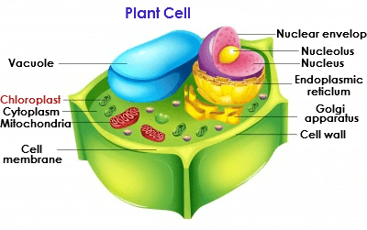
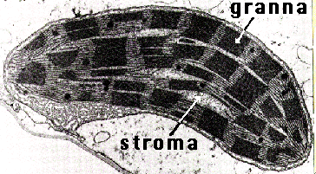
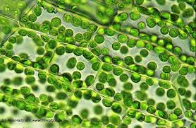
Chloroplasts

Slide 32
Light Dependant Reactions
During the light dependant reactions chlorophyll captures the energy from the sun
Electrons are excited and then passed onto high energy electron carriers.
The electrons are replaced by using some from water molecules which are split, taking the H⁺ ions and leaving O atoms. This is where the O₂ produced by photsynthesis comes from.
In addition ATP is also restored from ADP + P by ATPsynthase.
The light dependant reactions consist of photosystem I, an electron transport chain and photosystem II.

Slide 33
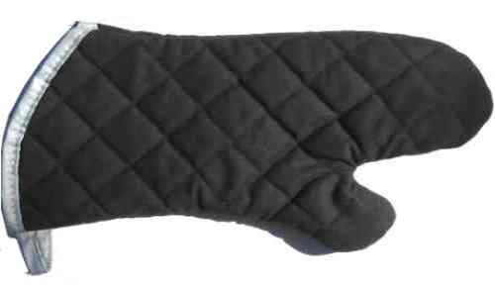
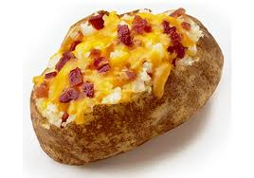
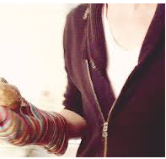
High Energy Electron Carriers
Once the electrons have been excited by the light dependant reactions in photosynthesis cells need a molecule to carry them safely
This role is fulfilled by NADP⁺ in photosynthesis. NADP⁺ picks up a high energy electron and becomes NADPH.
NADP+ + H+ = NADPH
+
=

Slide 34
Light Independent Reactions
During the light independent phase the ATP and the NADPH made during the light reactions is used to fixate carbon from atmospheric CO₂.
This is known as carbon fixation

Slide 35
What do you think will happen if there is no energy from the light dependant cycle?

Slide 36
Photosynthesis

Slide 37
Photosynthesis
C₆H₁₂O₆
6H₂O
6CO₂
+
+
>> light >>
6O₂

