Slide 1
Regulating Cell Cycles
Section 10.3

Slide 2
Regulating Cell Cycles
One of the most striking aspects of complex multicellular organisms is how carefully cell division takes place.
We are all familiar with many of the various cancers which we hear about almost daily. Cancers are examples of uncontrolled cellular growth.
What is amazing is that most of the time cell growth is perfectly controlled.

Slide 3
Regulating Cell Cycles
Not all cell types move through the cell cycle at the same speed.
Cells in the skin, digestive tract, and bone marrow grow and divide rapidly. Passing through the cell cycle in just a few hours.
In contrast muscle cells and nerve cells do not divide at all once they have developed.

Slide 4
Controls on Cell Division
If we were to grow cells in a petri dish we might start with 3 small clumps of cells.
The cells would grow and divide until they came into contact with other cells.
If we were to remove cells from the middle of the dish the cells nearest the gap would divide until the gap is again covered.
This shows that cellular division can be turned on and off.

Slide 5
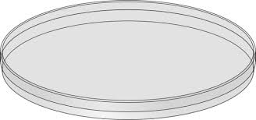
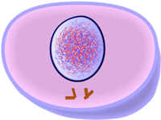

Slide 7
Controls of Cell Division
This is similar to what happens when someone receives a cut.
The cells at the edges of the cut a stimulated to grow and the cut heals.
Once the wound has closed up completely cell division will stop.

Slide 8
Cell Cycle Regulators
For many years biologists were searching for a substance that might regulate the cell cycle.
Eventually scientists discovered a group of proteins known as cyclins.
Cyclins regulate the cell cycle in eukaryotic cells.
They discovered that the amount of this protein in the cell rose and fell in time with the cell cycle.

Slide 9
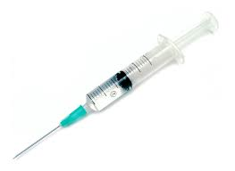
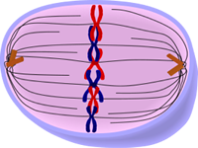
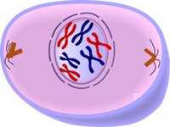
Experiments to show the effects of cyclin
A sample of cytoplasm is removed from a cell in mitosis
It is then injected into a cell in G₂ of interphase
As a result the second cell enters mitosis

Slide 10
Internal Regulators
Cells contain internal regulators which allow the cell to proceed only when certain processes have happened inside the cell.
For example regulatory proteins make sure a cell does not enter mitosis until all its chromosomes have been replicated.

Slide 11
Internal Regulators
Another regulatory protein prevents a cell from entering anaphase until all its chromosomes are attached to the mitotic spindle.

Slide 12
External Regulators
Proteins that respond to events outside the cell are called external regulators.
External regulators direct cells to speed up or slow down the cell cycle.
One group of external regulators are known as growth factors. They stimulate the growth and division of cells.
Growth factors play a particularly important role in embryonic development and wound healing.

Slide 13
External Regulators
Molecules on the surface of neighboring cells often have the opposite effect, slowing down or stopping the cell cycle. In this way the tissues of the body can be stopped from disrupting each other.
These molecules act like the sides of the petri dish we saw earlier.

Slide 14
Uncontrolled Cell Growth
Cell growth is regulated very carefully.
The principal reason for this is that uncontrolled cell growth in a multicellular organism is a very serious condition known as cancer.
Cancer cells do not respond to the signals that regulate the growth of most cells.

Slide 15
Cancer
Cancerous cells undergo uncontrolled cellular growth and division.
As a result they form masses of cells known as tumors. These tumors can cause damage to surrounding tissue.
Cancer cells may break loose from tumors and spread to other parts of the body. This can cause serious medical issues and even death.

Slide 16
The Causes of Cancer
Cancer can be caused by exposure to tobacco, radiation, and even viral infection.
All cancers share the fact that control of cellular growth, either externally or internally has been disrupted.
Many cancers share one commonality. The cells have a defect in the p53 gene. This causes cells to lose their responsiveness to regular controls.
Cancer is a disease of the cell cycle. In order to find a cure for cancer scientists will need a much deeper understanding of the cell cycle. However our level of understanding has greatly increased over the past several years.

