Slide 1
The Process of Cell Division
Section 10.2

Slide 2
Cell Division
What would happen if a cell simply split into two?
We would have no way of knowing if each new cell had a full compliment of genetic information.
Cell division in prokaryotic cells is a fairly simple procedure once the genetic information has been copied.
As Eukaryotic cells typically have multiple chromosomes division is more complex.
Cell division is therefore split into two main components – Mitosis and Cytokinesis.

Slide 3
Mitosis
During Mitosis the cells genetic information is copied and 2 full copies of genetic information are separated from each other.
Mitosis is also the source of new cells in a multicellular organisms.
It is considered asexual as the cells produced are exact copies of the original.

Slide 4
Mitosis

Slide 5
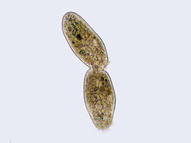
Cytokinesis
The second stage of cell division is known as cytokinesis.
This is when the cytoplasm of a cell is divided to form two daughter cells.

Slide 6
Chromosomes
In eukaryotic cells DNA is divided up into chromosomes, which carry the cells genetic information.
Chromosomes consist of the genetic information in the form of DNA wrapped in proteins (histones).
During cell division the DNA is condensed into the visible form of a chromosome that we are more used to seeing.

Slide 7
Sister Chromatids
Before cell division each chromosome is replicated. This creates the double pronged image of “sister” chromatids that we are used to seeing in images.
During cell division the sister chromatids are separated leaving each new cell with a full compliment of genetic information.

Slide 8
Chromosomes

Slide 9
The Cell Cycle
The cell cycle is the series of events that cells go through as they grow and divide.
During this cycle a cell grows, prepares for division, then divides forming two daughter cells.
Each of these daughter cells then begins the cell cycle again.

Slide 10
The Cell Cycle

Slide 11
The Cell Cycle
The cell cycle consists of 4 phases. The 2 phases of division (mitosis and cytokinesis) take place during the 4th phase – M phase of the the cycle.
The remaining 3 Phases are termed collectively interphase.
A copy of the genetic code (DNA) is made during the S phase.
The other two phases are G₁ and G₂. the G stands for gap but the periods are actually periods of intense growth.

Slide 12
G₁, S, and G₂ Phases
The G₁, S, and G₂ phase are collectively termed interphase.
During the G₁ phase cells undergo most of their growth. They increase in size and synthesize new proteins and organelles.
During the S phase chromosomes are replicated – creating sister chromatids.
The G₂ phase is the shortest of the cell phases. During this phase many of the organelles and molecules needed for cell division are produced.

Slide 13
Interphase

Slide 14
The M Phase
During the M phase the cell undergoes the process of mitosis and cytokinesis
Mitosis is sub divided into four phases; prophase, metaphase, anaphase, telophase.
Once these phases are complete the cell undergoes cytokinesis.

Slide 15
Mitosis

Slide 16
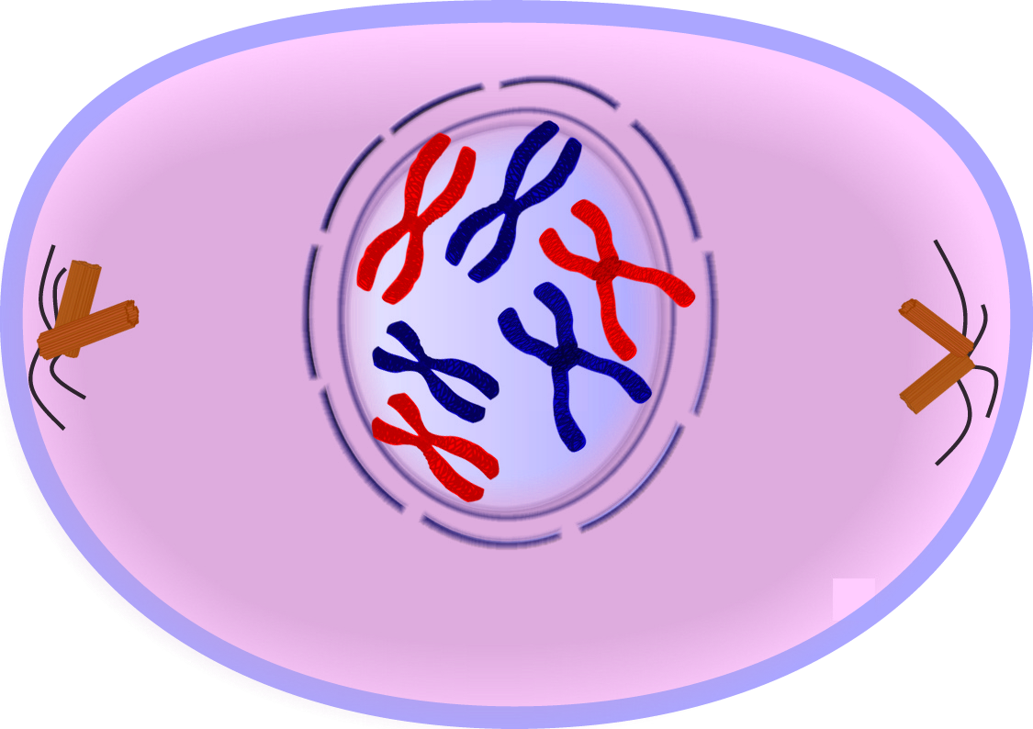
Prophase

Slide 17
Prophase
The chromatin condenses into chromosomes
The centrioles separate, move to the polls and a spindle begins to form. The centrioles lie in regions called the centrosomes
The nuclear envelope breaks down

Slide 18
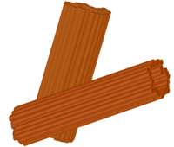
Centrioles
Centrioles: two tiny structures located in the cytoplasm near the nuclear envelope that separate and take up positions on opposite sides of the cell.
Centrosomes: the region where the centrioles lie that helps organize the spindle
Spindle: fanlike microtubule structures that help separate the chromosomes.

Slide 19
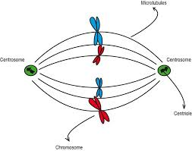
Centrosomes

Slide 20
Metaphase
The chromosomes line up across the center of the cell. This is termed the meta-phase plate
Each chromosome is connected to a spindle fiber at its centromere
Remember these ‘phases’ are a dynamic process and division moves from one phase to the next seamlessly

Slide 21
Pro-metaphase

Slide 22
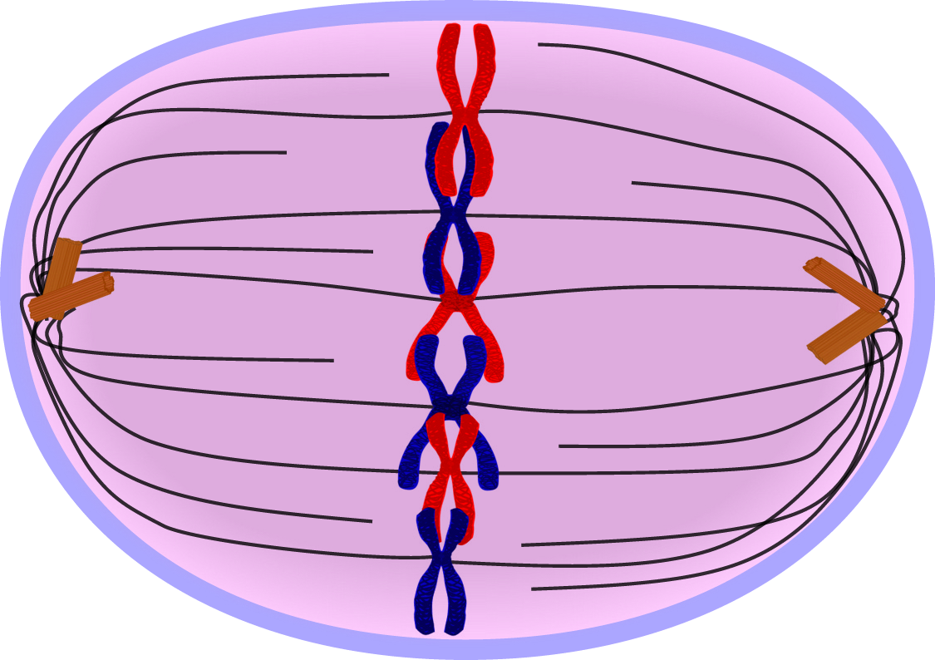
Metaphase

Slide 23
Anaphase
The centromeres that join the sister chromatids split – the sister chromatids become individual chromosomes.
The chromosomes continue to move apart until they have separated into two groups near the poles of the spindle
Anaphase ends when the chromosomes stop moving

Slide 24
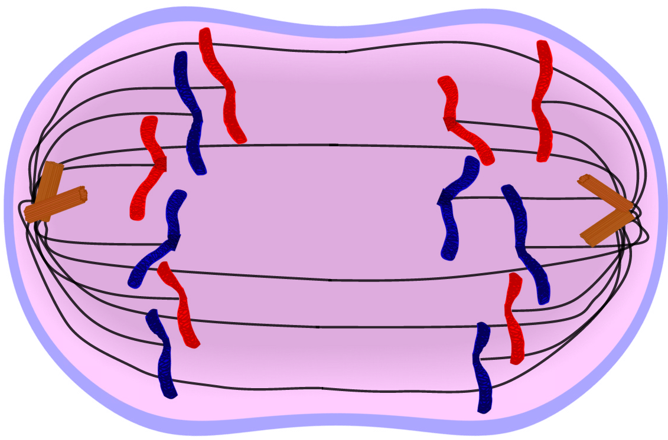
Anaphase

Slide 25
Telophase
The chromosomes begin to disperse into a tangle of dense material (chromatin)
A nuclear envelope reforms around each cluster of chromosomes
The spindle begins to break apart and a nucleolus becomes visible in each daughter nucleus
Mitosis is complete but cell division is not yet over.

Slide 26
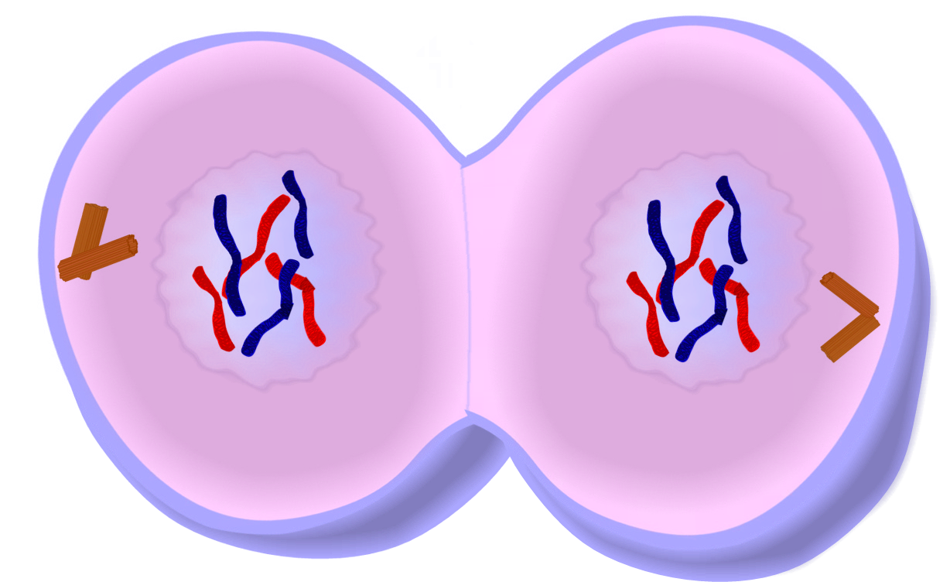
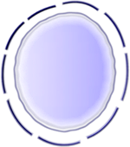
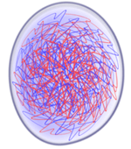
Telophase

Slide 27
Cytokinesis
After mitosis we are left with two nuclei each with identical copies of chromosomes.
Cytokinesis is the division of the cytoplasm and will complete the M phase.
In animal cells the cell membrane is drawn in until the cytoplasm is pinched of into two equal parts.
In plants a cell plate forms. This plate develops into a membrane and then a cell wall begins to form in the cell plate.

Slide 28
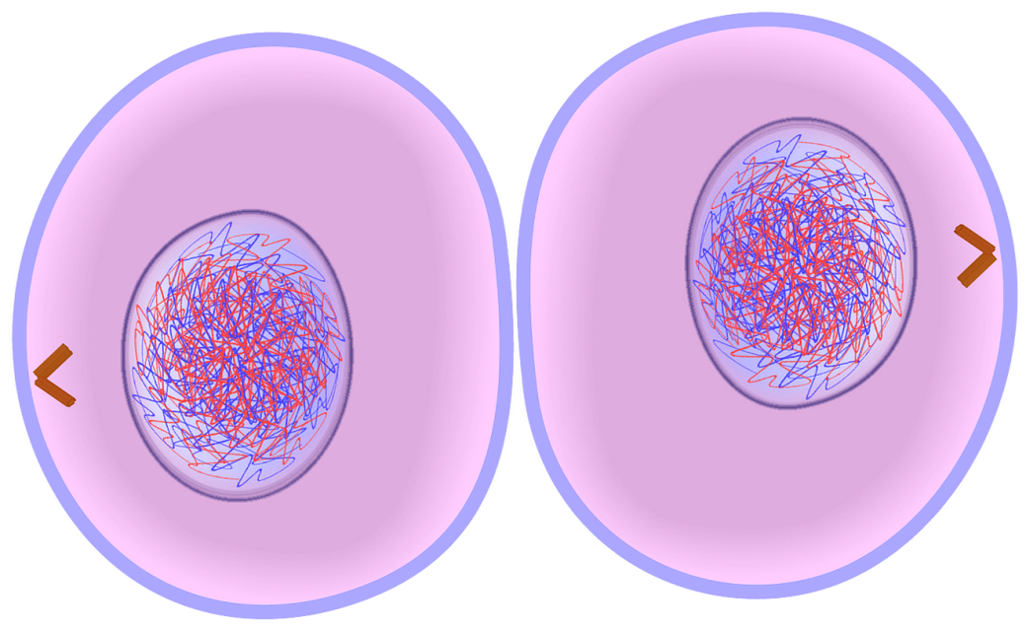
Cytokinesis

Slide 29
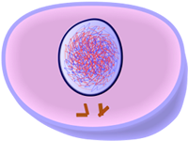
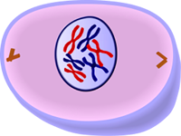
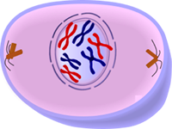
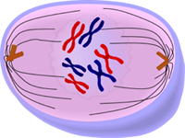
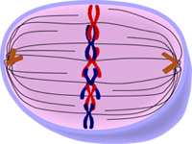
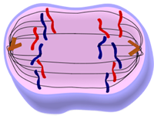
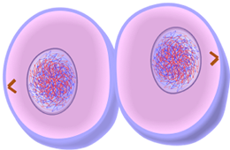
Mitosis Overview
Interphase – G₁
Interphase – S and G₂
Prophase
Pro-metaphase
Metaphase
Anaphase
Telophase
Cytokinesis

Slide 30
Late Interphase (G₂)

Slide 31
Early prophase

Slide 32
Prophase

Slide 33
Pro-metaphase

Slide 34
Metaphase

Slide 35
Anaphase

Slide 36
Telophase

Slide 37
Cytokinesis

Slide 38
Cell Division Overview
Interphase
Normal activity and growth
G₁ - gap 1, cell undergoes most growth
G₂ - gap 2, produces many of the organelles needed for division
M Phase
Prophase - chromatin condenses, centrioles move to the poles, spindles start to form, nuclear envelope breaks down
Metaphase - chromosomes connected to spindle fiber at centromere and lined up at equator of cell (metaphase plate)
Anaphase - sister chromatids split, chromosomes move apart, anaphase ends when chromosomes stop moving
Telophase – chromosomes begin to untangle into chromatin, nuclear envelope reforms, spindle breaks up. Mitosis ends.
Cytokinesis
Division of cytoplasm
S - synthesis, cell makes a copy of DNA
The process of dividing the DNA
Two nuclei with identical DNA
The cytoplasm is divided between the two new cells
Cell membrane is pinched in to separate the two daughter cells
In plats a cell plate forms and then a new cell wall

Slide 39
Websites
Cell division
Mitosis
http://www.youtube.com/watch?v=VGV3fv-uZYI&list=PLB261A77941D856DC

